Slide 1
Ryan’s Datadog Code Exercise

Slide 2
## Prerequisites - Setup the environment
Part 1

Slide 3
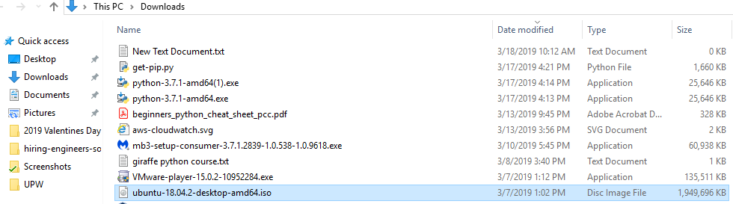
* You can spin up a fresh Linux VM
I used VMWare player since I am familiar with it. I downloaded an Ubuntu .iso file and I set VMWare Player to use that

Slide 4
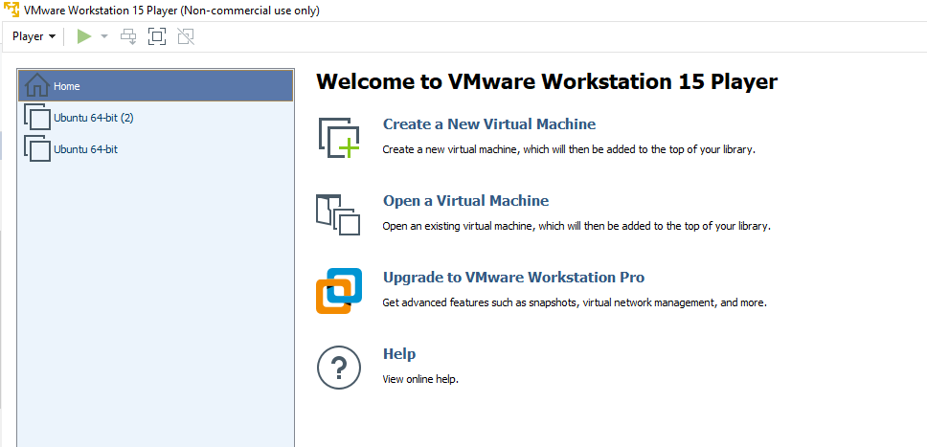
* You can spin up a fresh Linux VM
Here you can see the Ubuntu instances I created for this exercise. I used the first one to experiment with but the 2nd to do most of the exercise

Slide 5
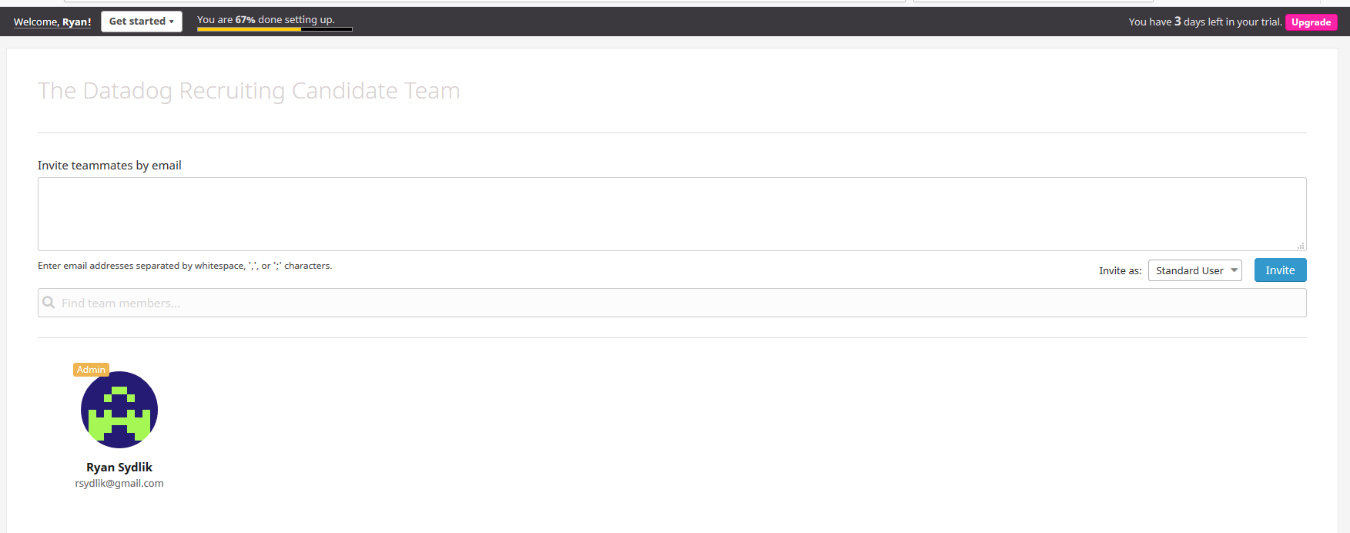
Then, sign up for Datadog
I signed up for a trial account. Here you can see the information about my trial account

Slide 6
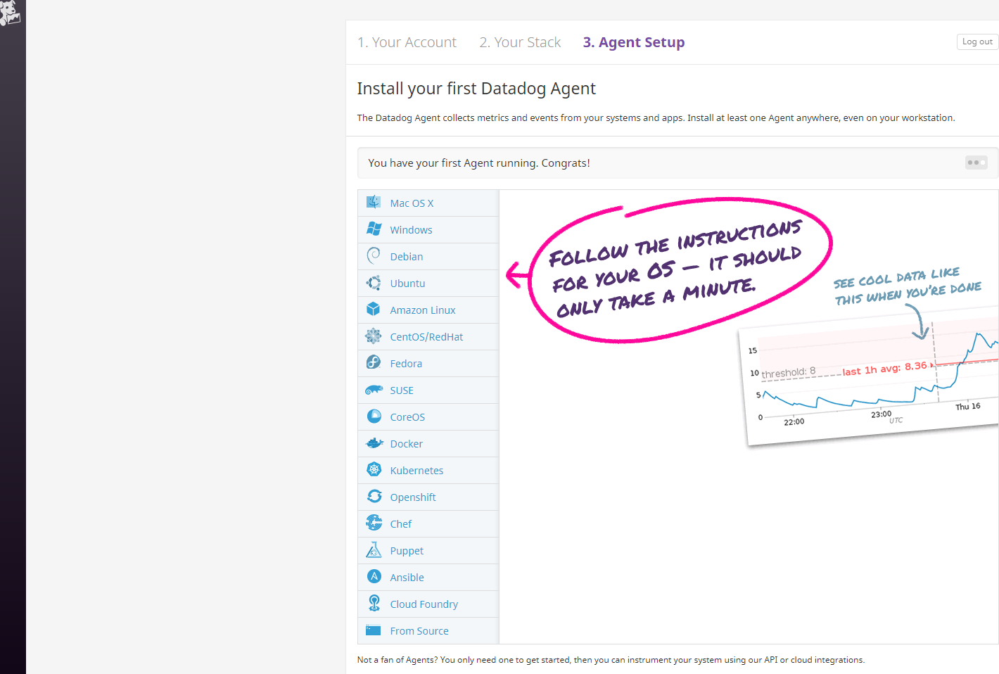
get the Agent reporting metrics from your local machine
From the setup screen, I selected Ubuntu

Slide 7
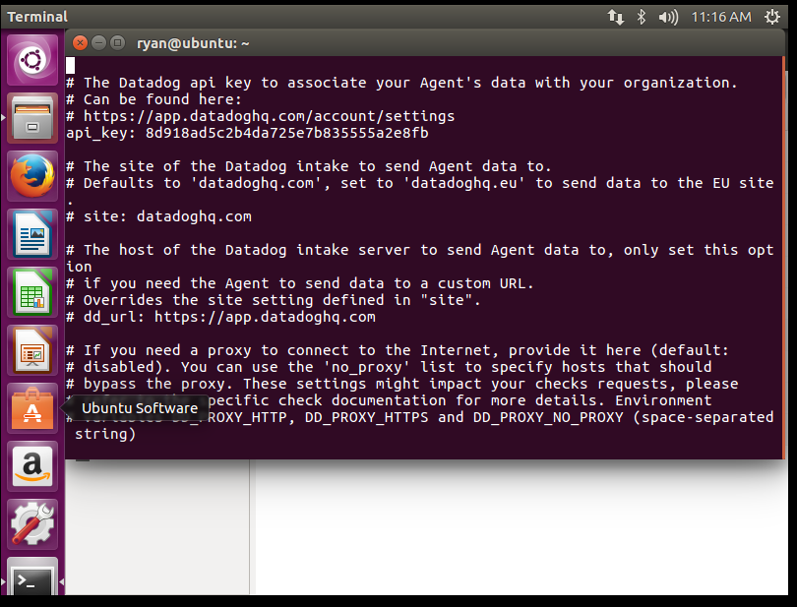
get the Agent reporting metrics from your local machine
Then I ran the command as instructed to setup the agent on my VMs
DD_API_KEY=8d918ad5c2b4da725e7b835555a2e8fb bash -c "$(curl -L https://raw.githubusercontent.com/DataDog/datadog-agent/master/cmd/agent/install_script.sh)"
The screen below shows successful installation of the agent

Slide 8
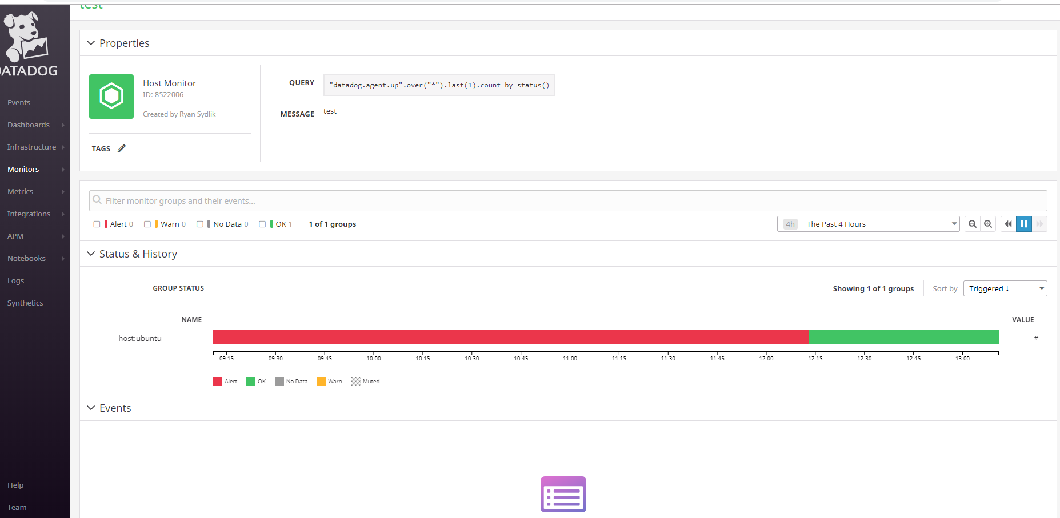
get the Agent reporting metrics from your local machine
I created a test monitor to validate that the VM is reporting data

Slide 9
## Collecting Metrics:
Part 2

Slide 10
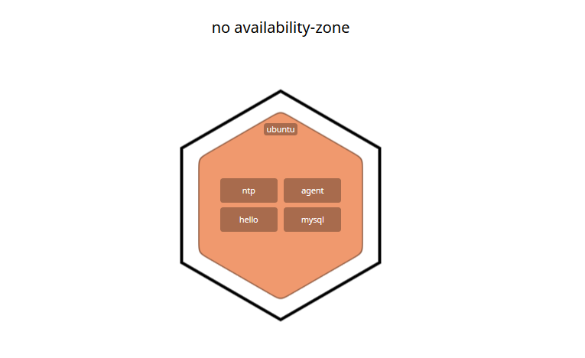
* Add tags in the Agent config file and show us a screenshot of your host and its tags on the Host Map page in Datadog.
The following shows my host in the Host Map. The hello and mysql tags were added per the activities I completed later in this section.

Slide 11
Install a database on your machine - MySQL
Rackspace has a great primer on setting up a mysql database. I followed https://support.rackspace.com/how-to/installing-mysql-server-on-ubuntu/ and ran the following commands on my VM
sudo apt-get update
sudo apt-get install mysql-server
systemctl start mysql
systemctl enable mysql
/usr/bin/mysql -u root –p
SELECT User, Host, authentication_string FROM mysql.user;

Slide 12
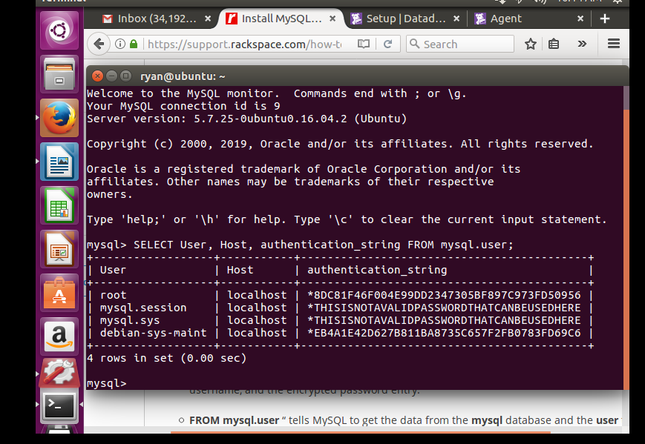
Install a database on your machine - MySQL
The following screen shows successful installation of the MySQL database and the users that were created on my VM.

Slide 13
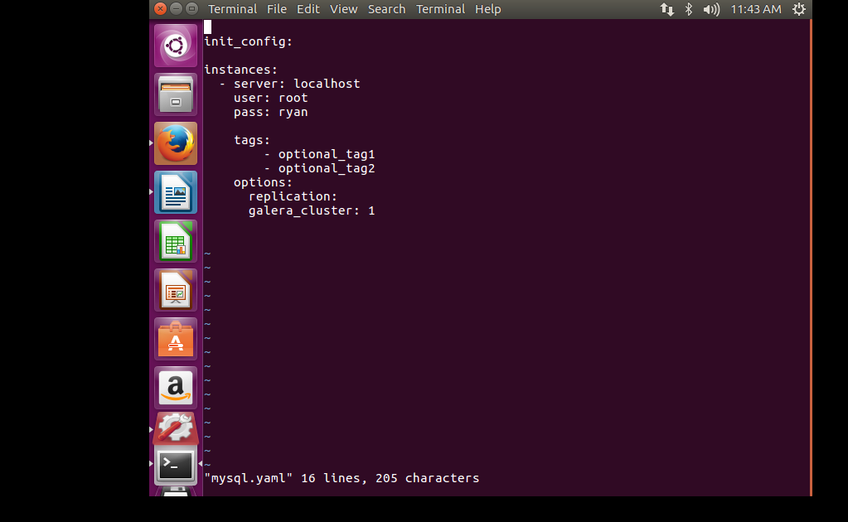
then install the respective Datadog integration for that database.
I navigated to the .yaml filed to enable mysql logging. The changes I made are shown below

Slide 14
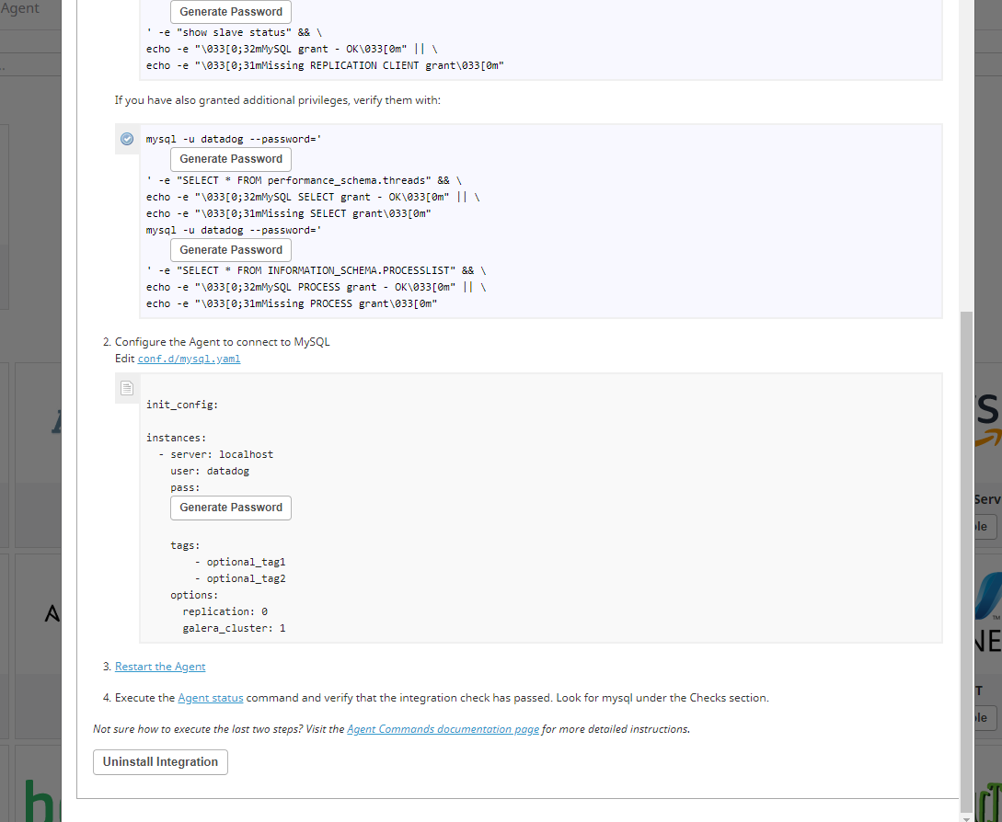
then install the respective Datadog integration for that database.
The screen below shows “Uninstall Integration” which means integration installation has occurred. Also, please note that I am using the root user for datadog so I did not have to address the DB privilege changes. Since this is only a test, that is OK.

Slide 15
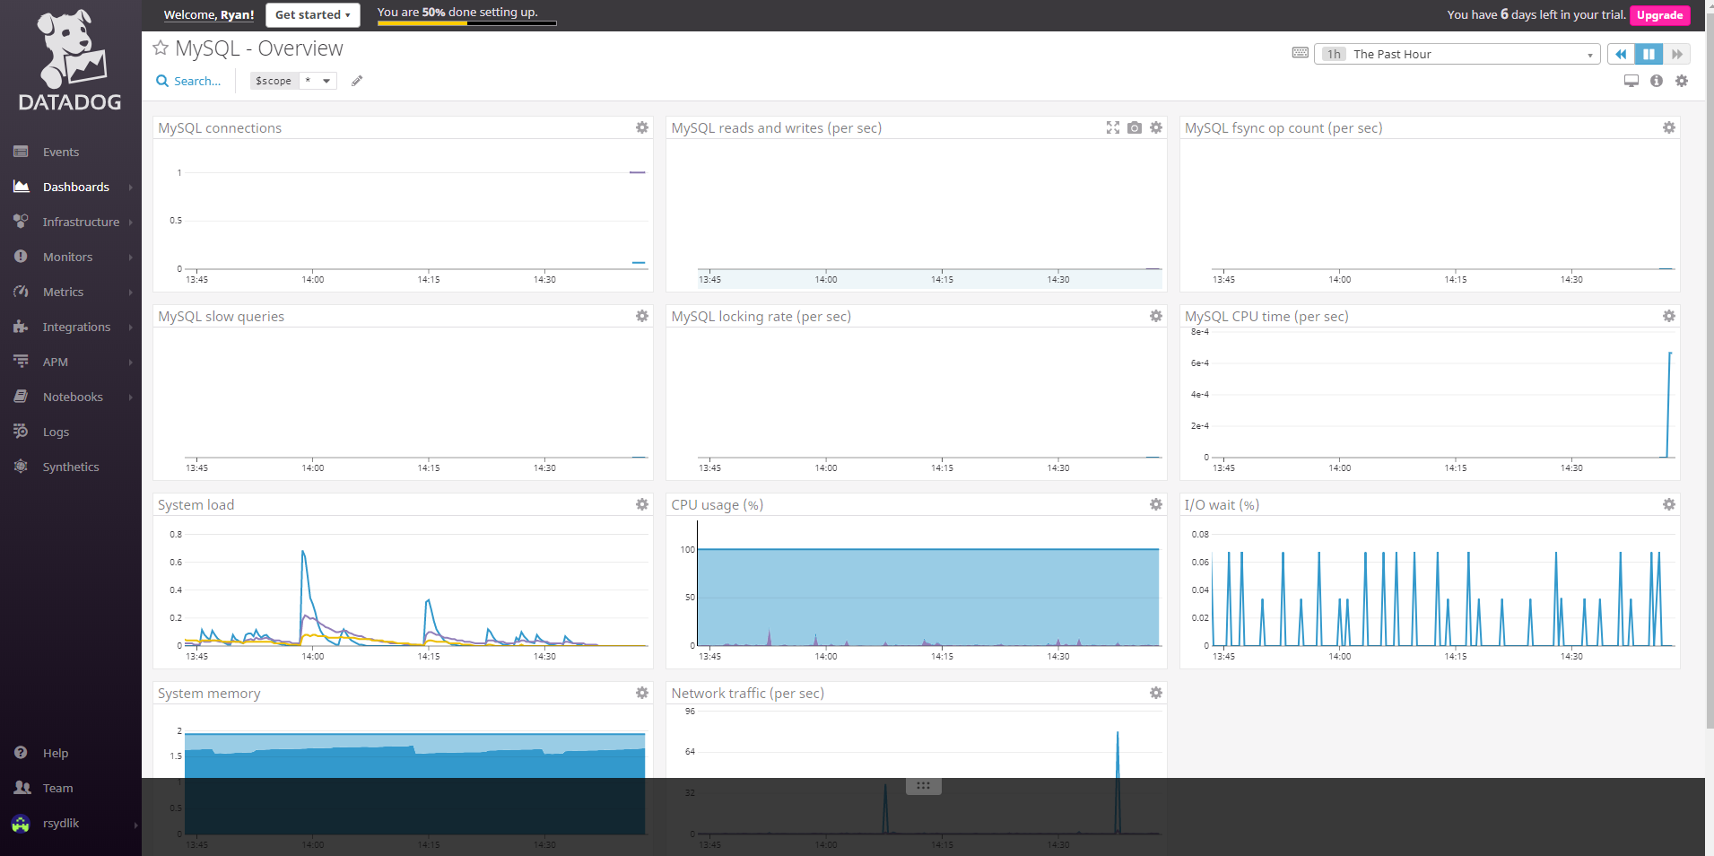
and then install the respective Datadog integration for that database.
The following dashboard shows up when integration is installed. The lines for the MySQL settings have just appeared so Datadog is successfully reading the data.

Slide 16
I chose to use a custom agent check, but it’s a little different than an RNG. It is a hello world statement. It is from https://docs.datadoghq.com/developers/write_agent_check/?tab=agentv6. I figured that would be great for simple debugging and that I can just tune the alarms to simulate state changes rather than have actual state changes.
* Create a custom Agent check that submits a metric named my_metric with a random value between 0 and 1000.

Slide 17
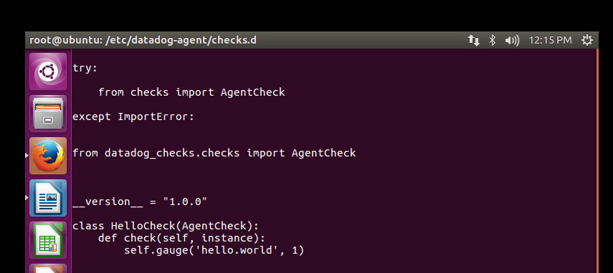
* Create a custom Agent check that submits a metric named my_metric with a random value between 0 and 1000.
I created conf.d/hello.yaml and checks.d/hello.py in /etc/datadog-agent and I input the check information in those location. The following screenshot show the check I used in checks.d

Slide 18
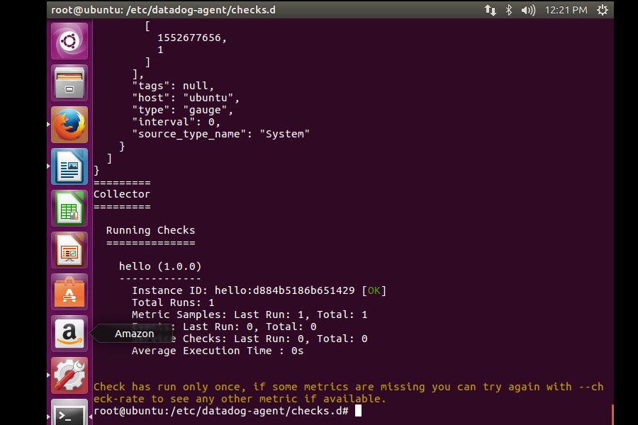
* Create a custom Agent check that submits a metric named my_metric with a random value between 0 and 1000.
I ran sudo -u dd-agent -- datadog-agent check hello.world to verify my check. It is showing as OK.

Slide 19
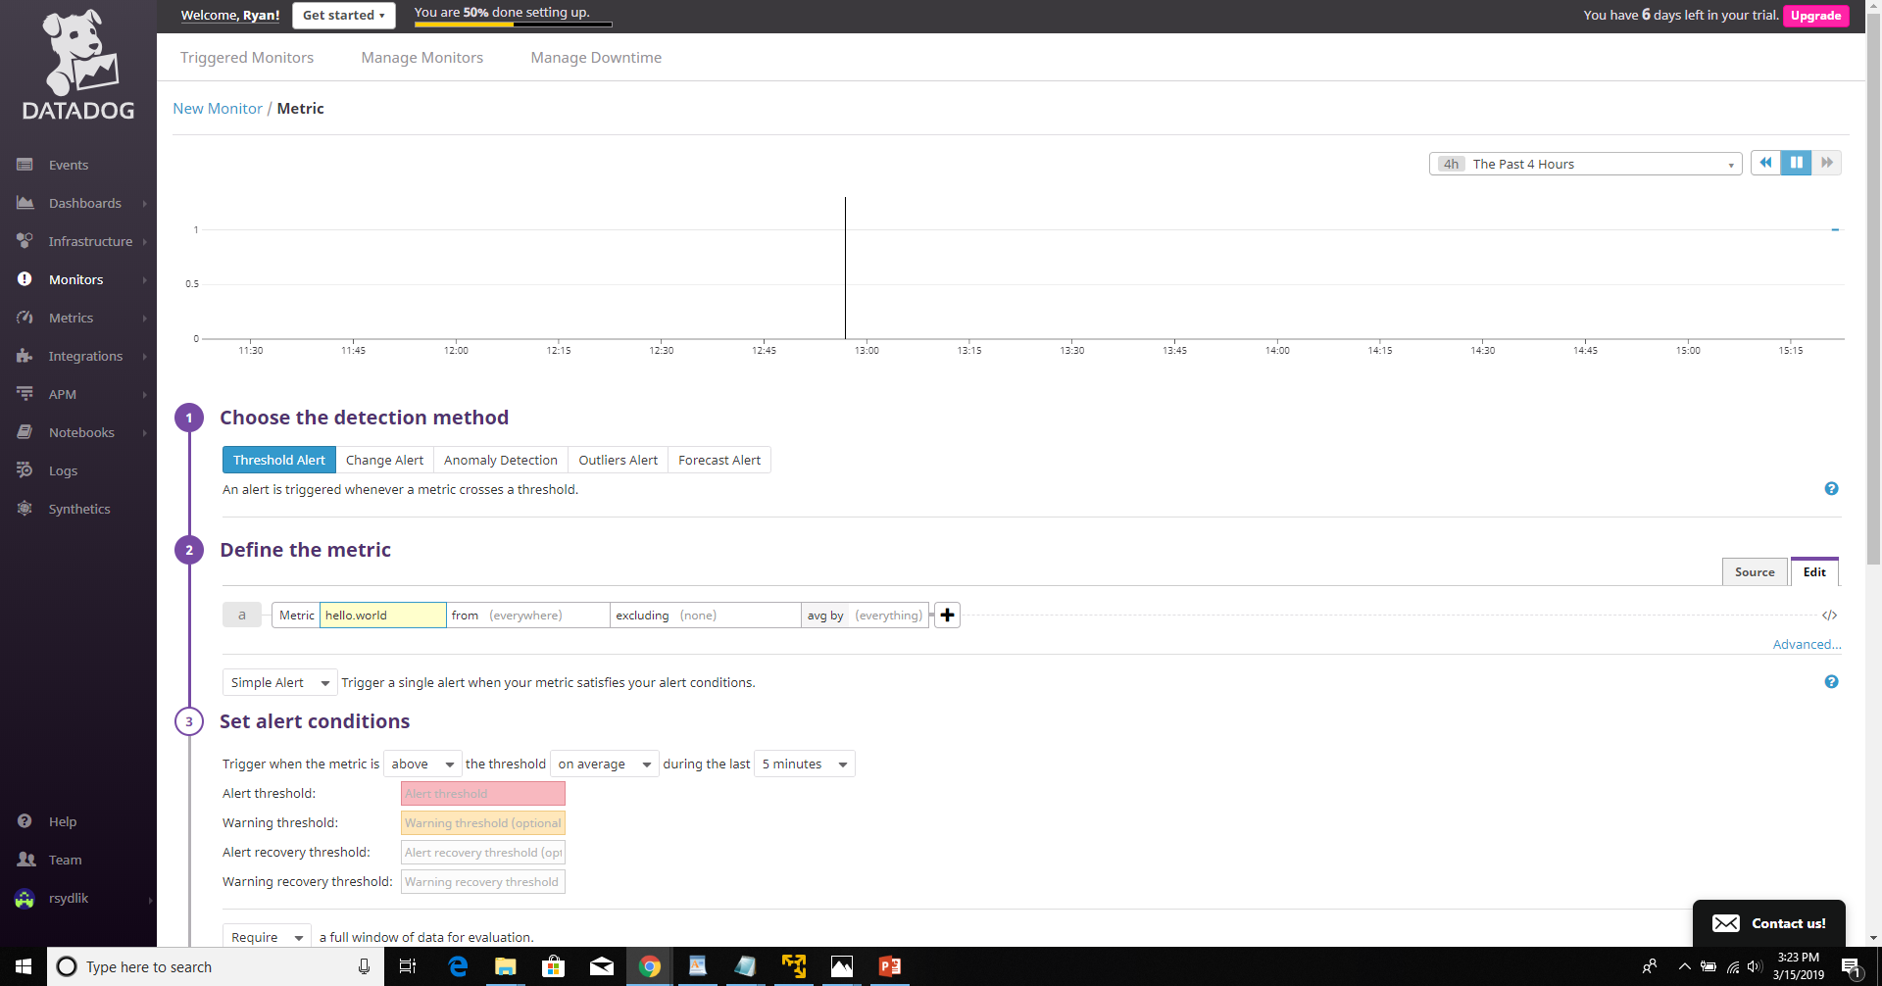
The metric is reporting in the monitors as a metric

Slide 20
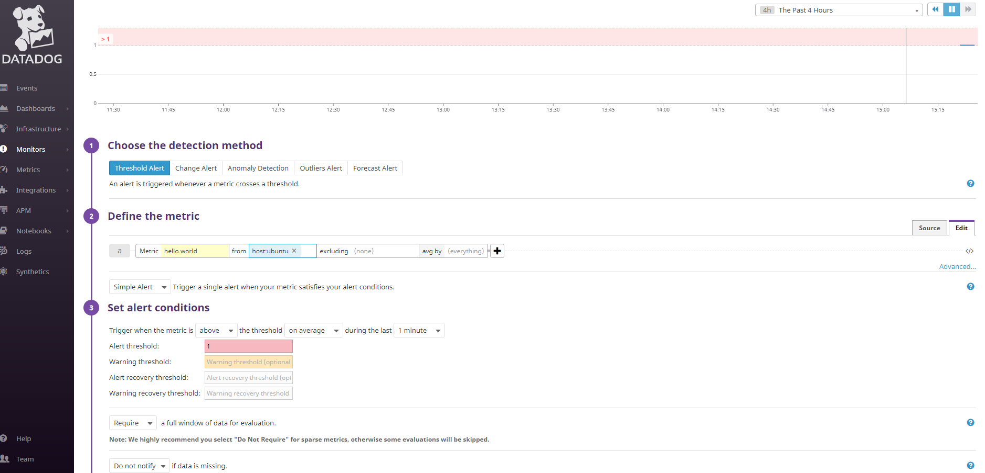
* Change your check's collection interval so that it only submits the metric once every 45 seconds. * **Bonus Question** Can you change the collection interval without modifying the Python check file you created?
I went straight to the bonus question. I set the threshold to be 1 minute in the monitor I created for the hello.world check which you can see below

Slide 21
## Visualizing Data:
Part 3

Slide 22
Utilize the Datadog API to create a Timeboard
Normally I would just use the interface and that is what I did to actually get the answers. However, I did want to demonstrate competency with the API so I did generate a sample Timeboard with the API. Here is how I did that.

Slide 23
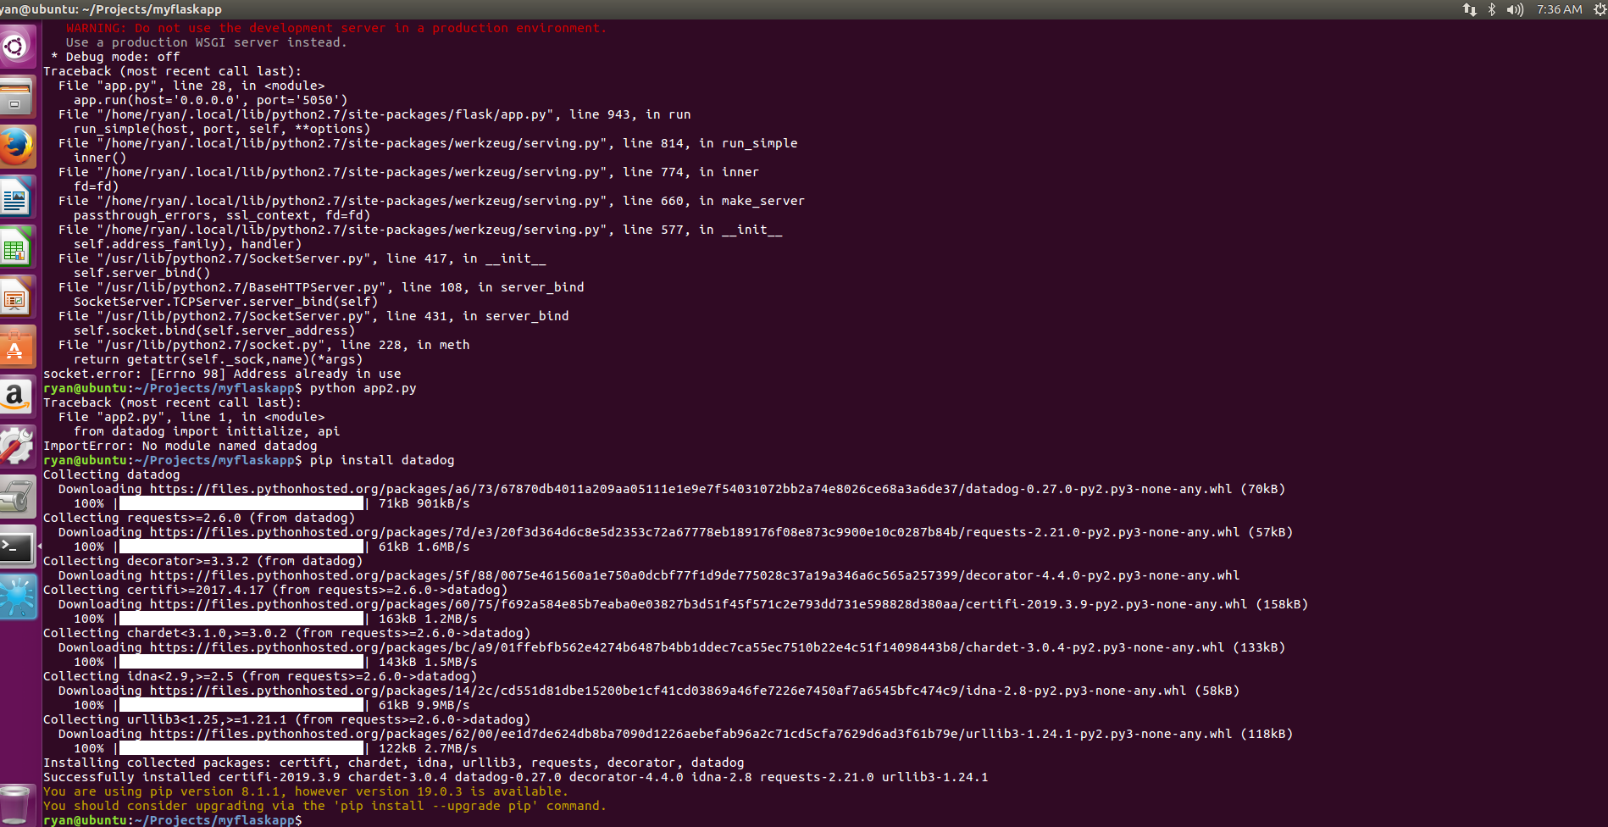
Utilize the Datadog API to create a Timeboard
I ran pip install datadog in python to install that datadog module.

Slide 24
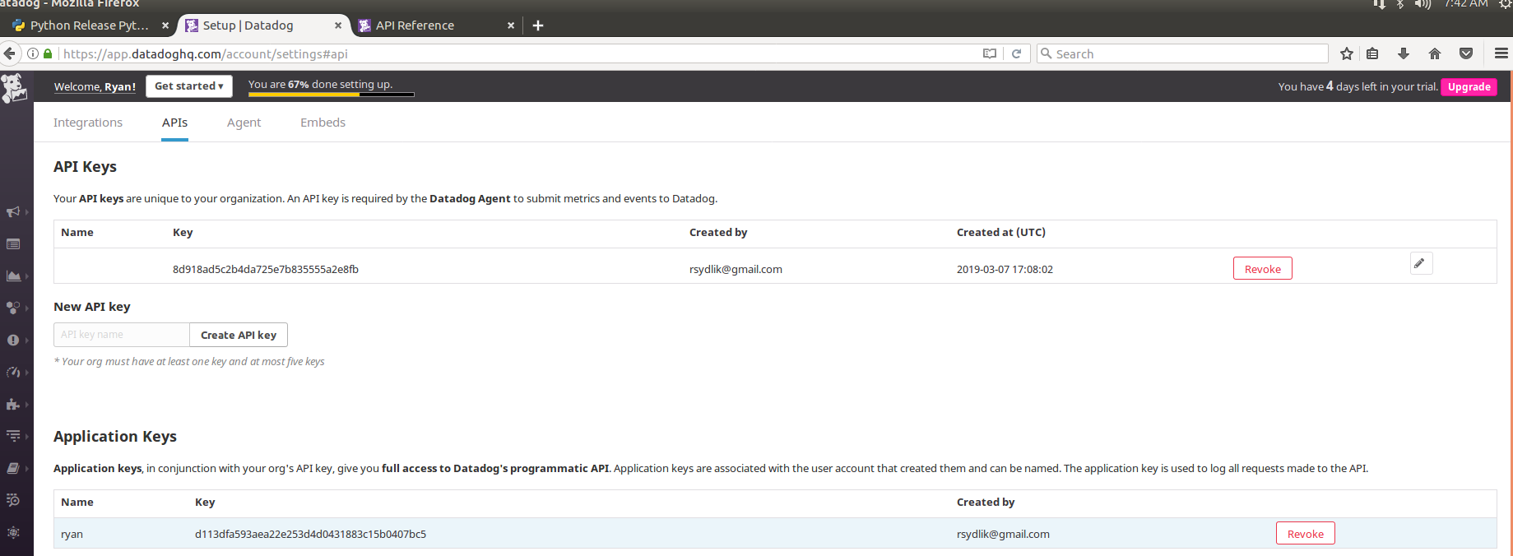
Utilize the Datadog API to create a Timeboard
I generated an application key, which is shown below.

Slide 25
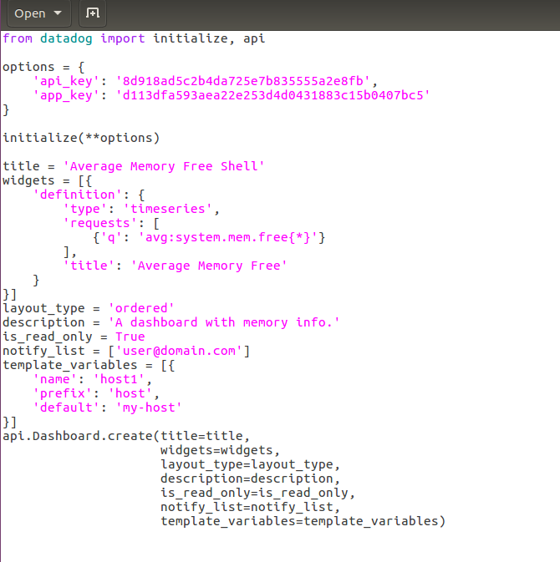
Utilize the Datadog API to create a Timeboard
I used https://docs.datadoghq.com/api/?lang=python#overview as a reference. I created the following python program from this source with the most obvious change being adding the actual keys.

Slide 26
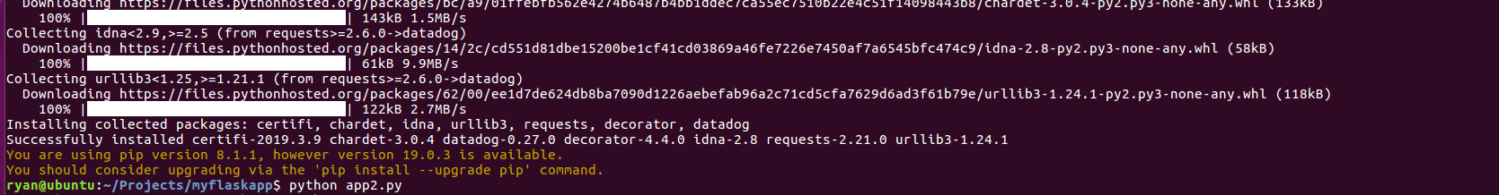
Utilize the Datadog API to create a Timeboard
I executed the python script.

Slide 27
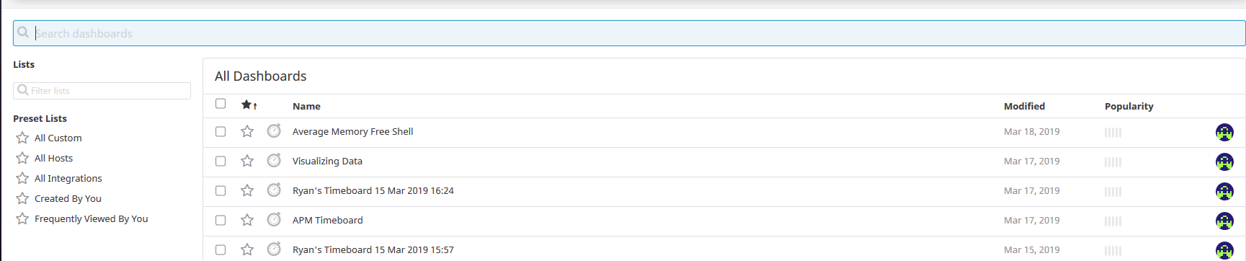
Utilize the Datadog API to create a Timeboard
The script created the “Average Memory Free Shell” Timeboard. Based on the below screenshot, you can tell I tackled the API step out of order.

Slide 28
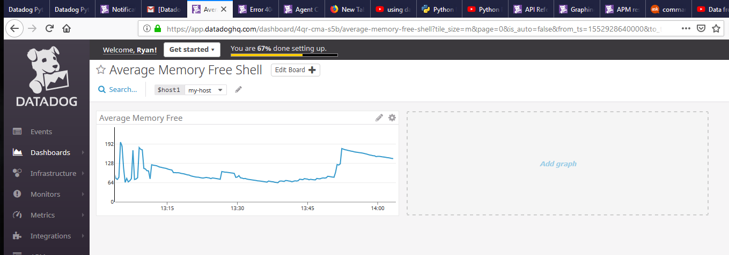
Utilize the Datadog API to create a Timeboard
https://app.datadoghq.com/dashboard/4qr-cma-s5b/average-memory-free-shell?tile_size=m&page=0&is_auto=false&from_ts=1552964280000&to_ts=1552967880000&live=true
The following screenshot shows the actual “Average Memory Free Shell” Timeboard.

Slide 29
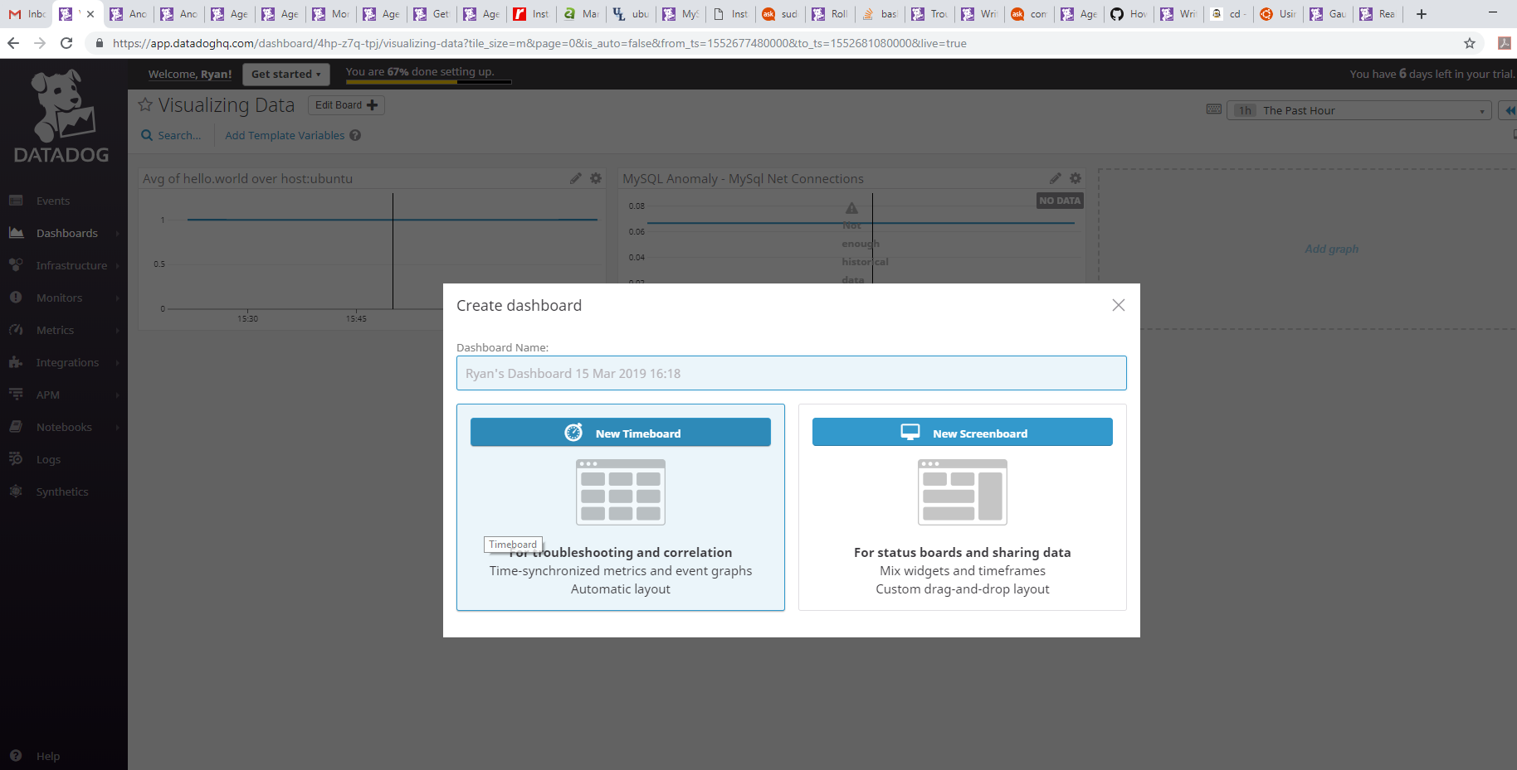
* Your custom metric scoped over your host.
To get the answers, I did the rest using the UI as that is how I create Timeboards at REAN. First, I created a new Timeboard.

Slide 30
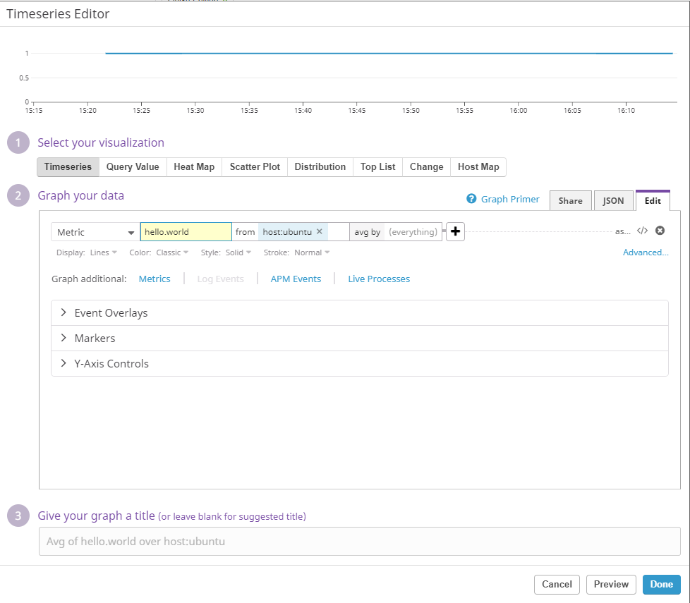
I created the following Timeseries graph using the hello.world metric. Unfortunately my custom metric is rather boring, but it still works for demonstration purposes. I have scoped it for the host “ubuntu”.
* Your custom metric scoped over your host.

Slide 31
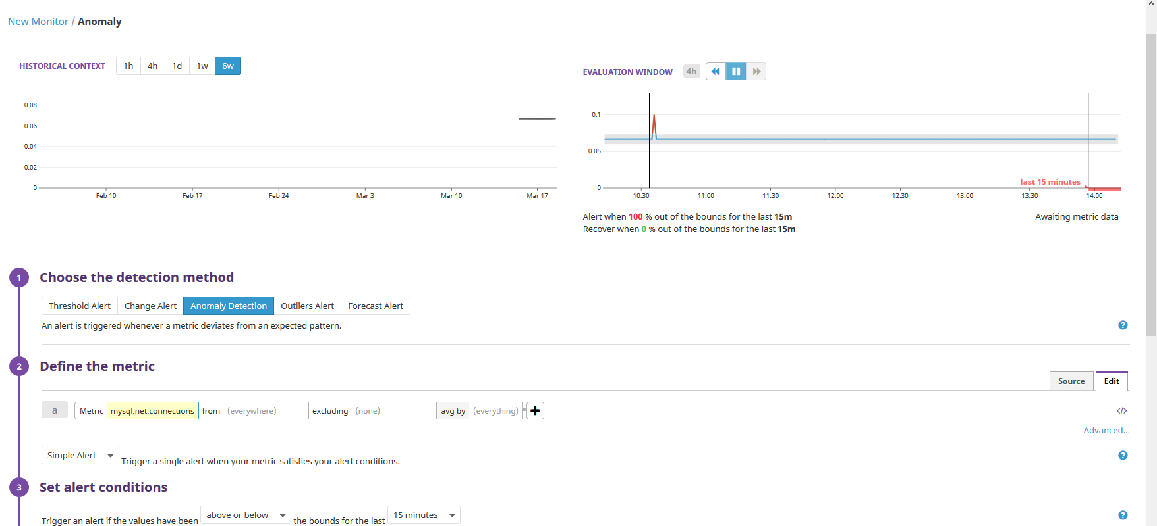
* Any metric from the Integration on your Database with the anomaly function applied.
I created an anomaly graph using the mysql_net.connections check

Slide 32
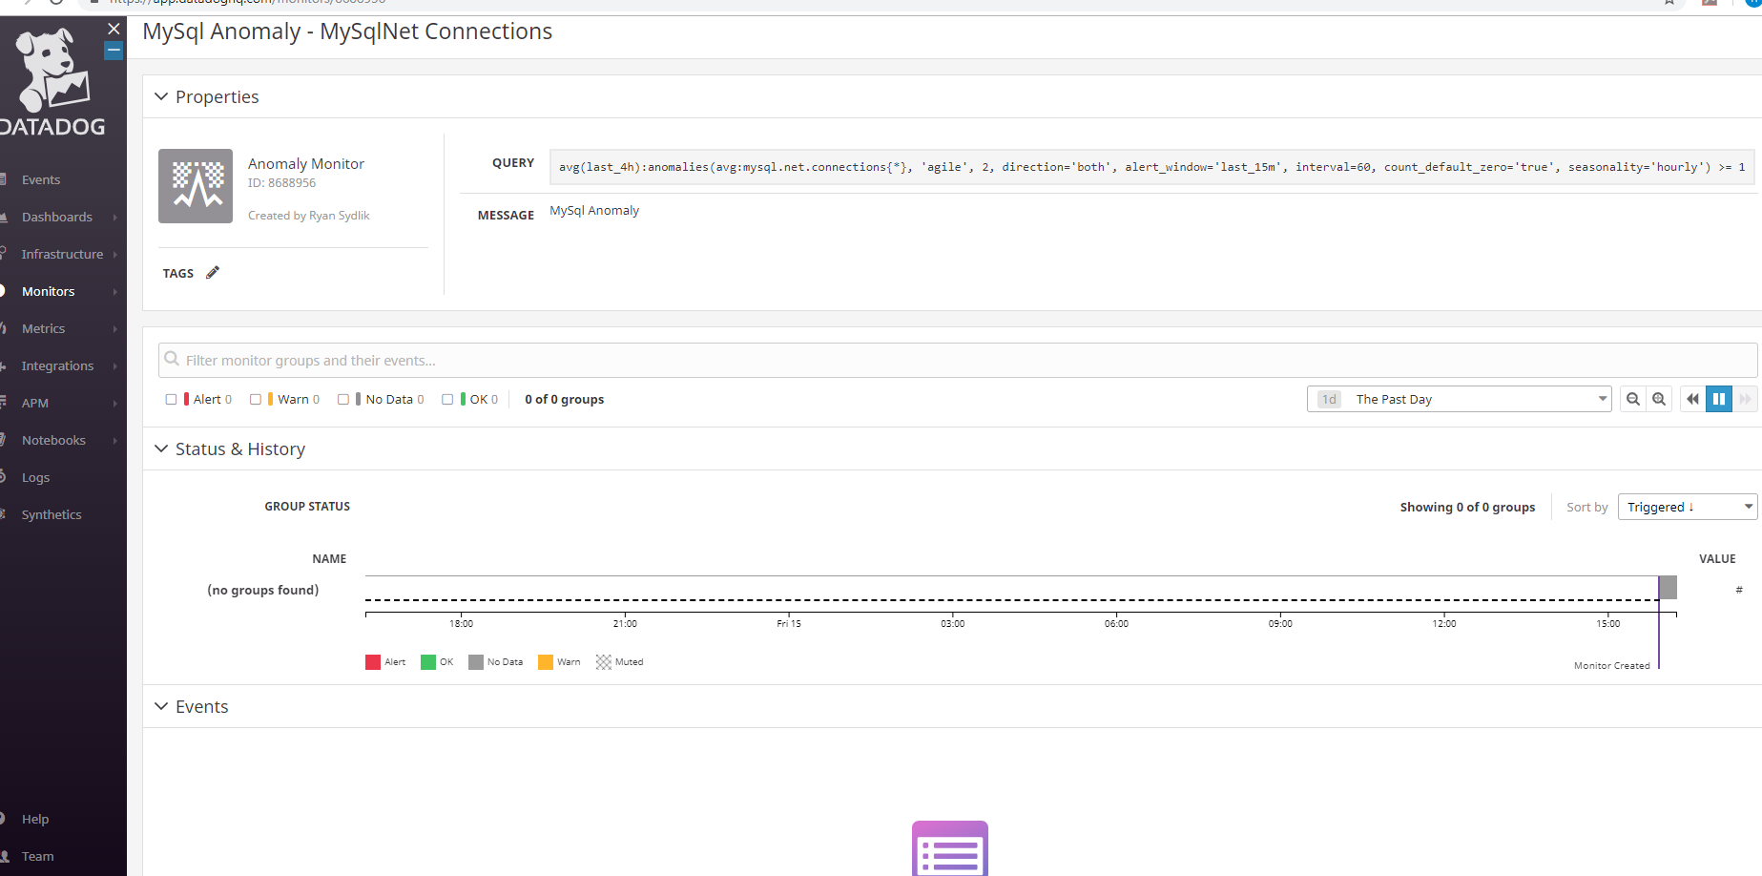
* Any metric from the Integration on your Database with the anomaly function applied.
Creation of this monitor is shown below

Slide 33
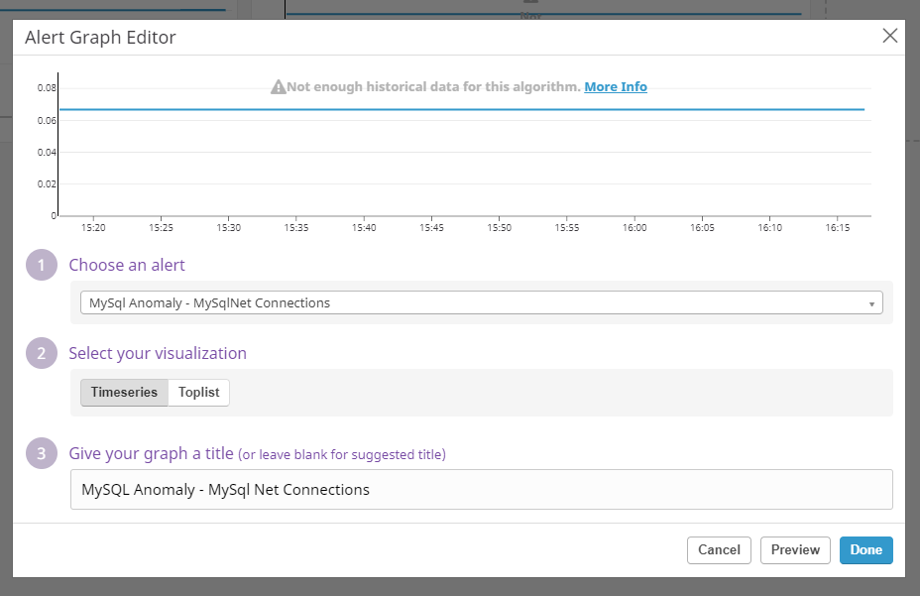
* Any metric from the Integration on your Database with the anomaly function applied.
I added this to the board using the Alert Graph selection.

Slide 34
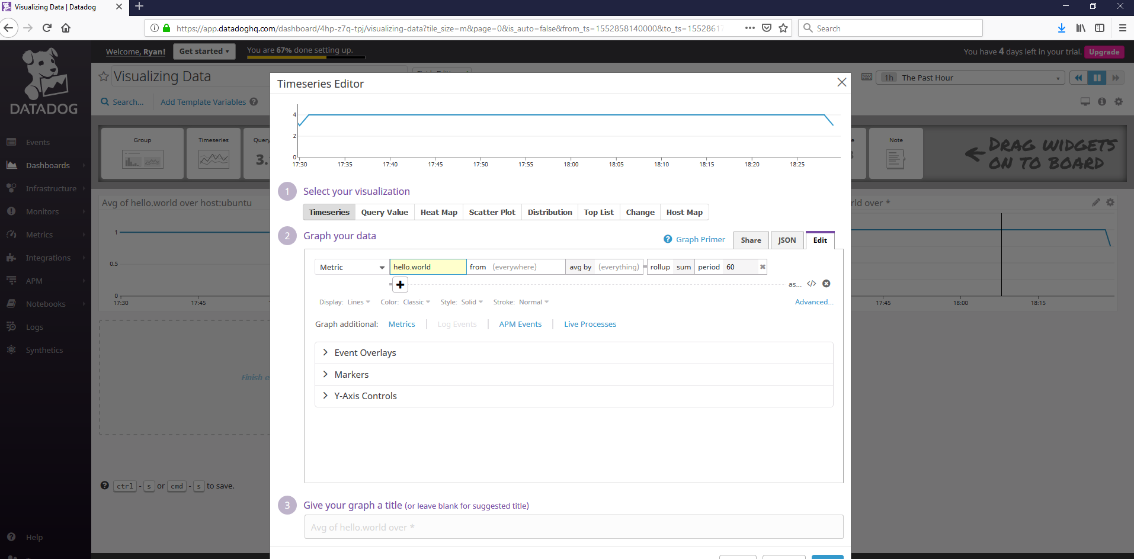
* Your custom metric with the rollup function applied to sum up all the points for the past hour into one bucket
I created the following graph using the rollup function with sum for a period of 60.

Slide 35
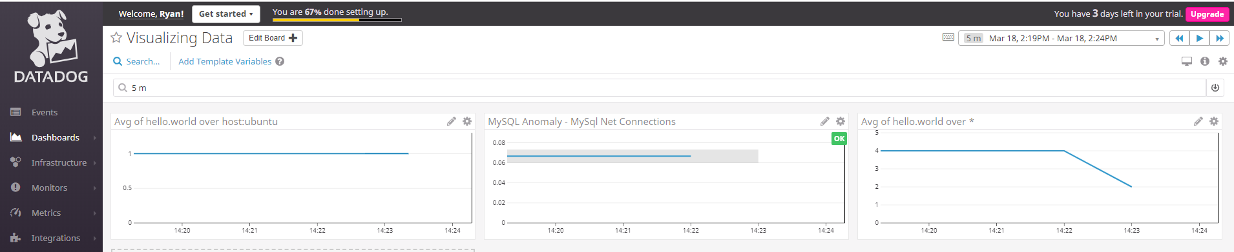
* Set the Timeboard's timeframe to the past 5 minutes
This one actually stumped me a for a bit as I can only set it to 15 on the upper right. But then, I made a selection on one of the graphs and was able to get it to 5 minutes.

Slide 36
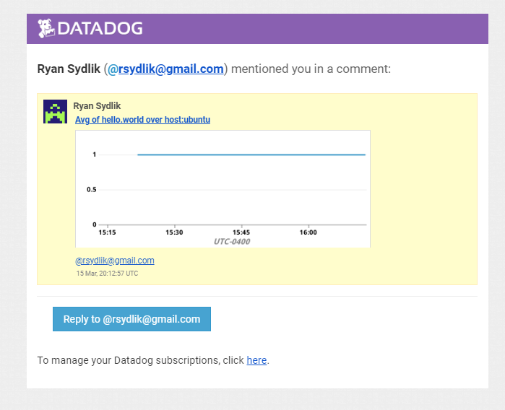
* Take a snapshot of this graph and use the @ notation to send it to yourself.
I took a snapshot and sent it to myself. You can see the email on the right.

Slide 37
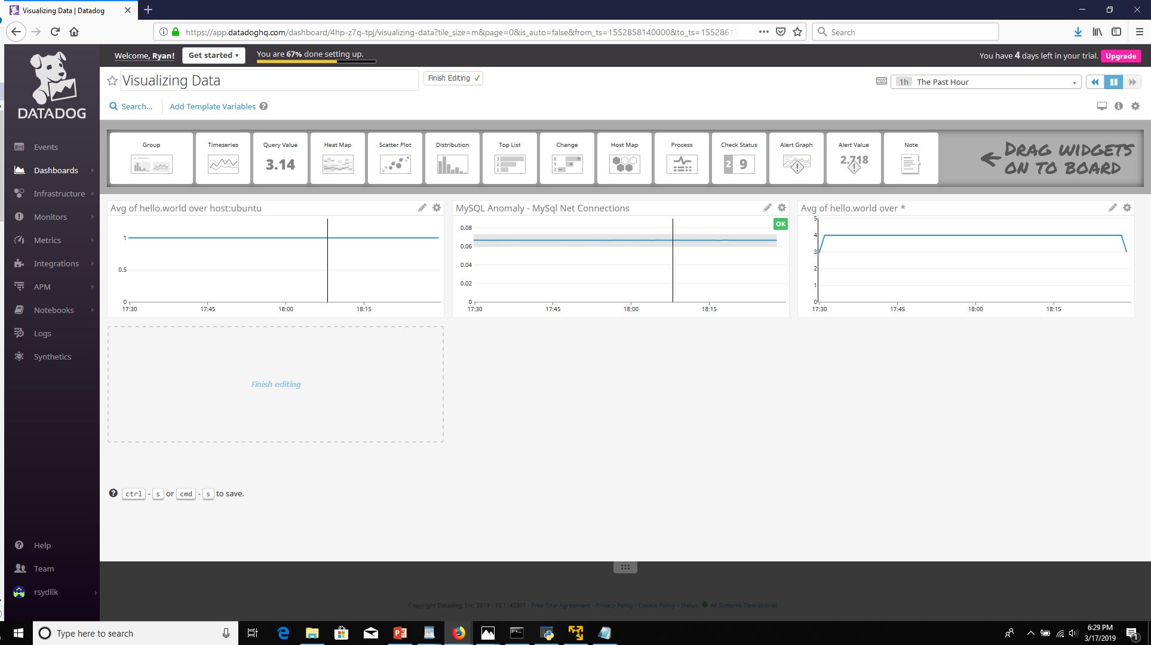
Here is the Timeboard with all the data
https://app.datadoghq.com/dashboard/4hp-z7q-tpj/visualizing-data?tile_size=m&page=0&is_auto=false&from_ts=1552966980000&to_ts=1552967880000&live=true

Slide 38
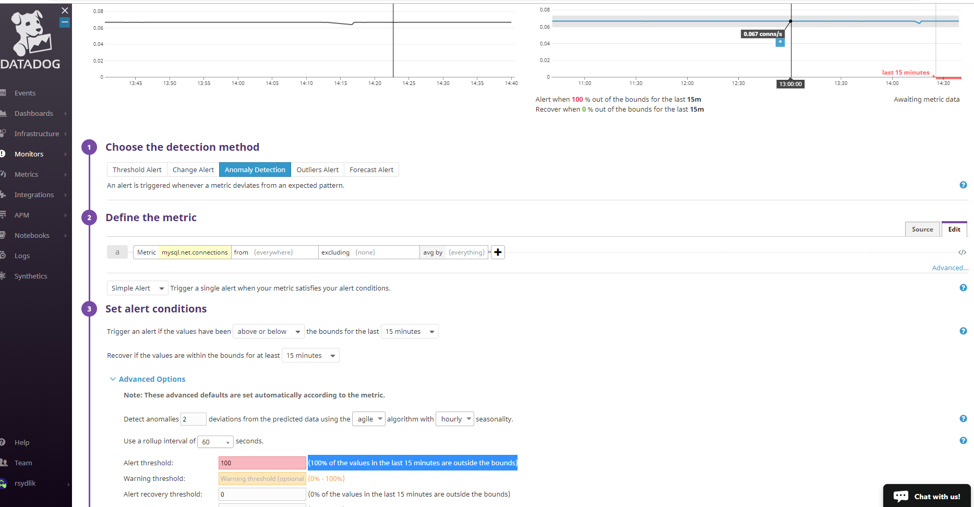
* **Bonus Question**: What is the Anomaly graph displaying?
The anomaly graph is determining if in the past 15 minutes, 100% of the values are out of the bounds that it uses machine learning to determine. In this case it is whether the values are approximately below 0.06 or above 0.075 net connections

Slide 39
## Monitoring Data
Part 4

Slide 40
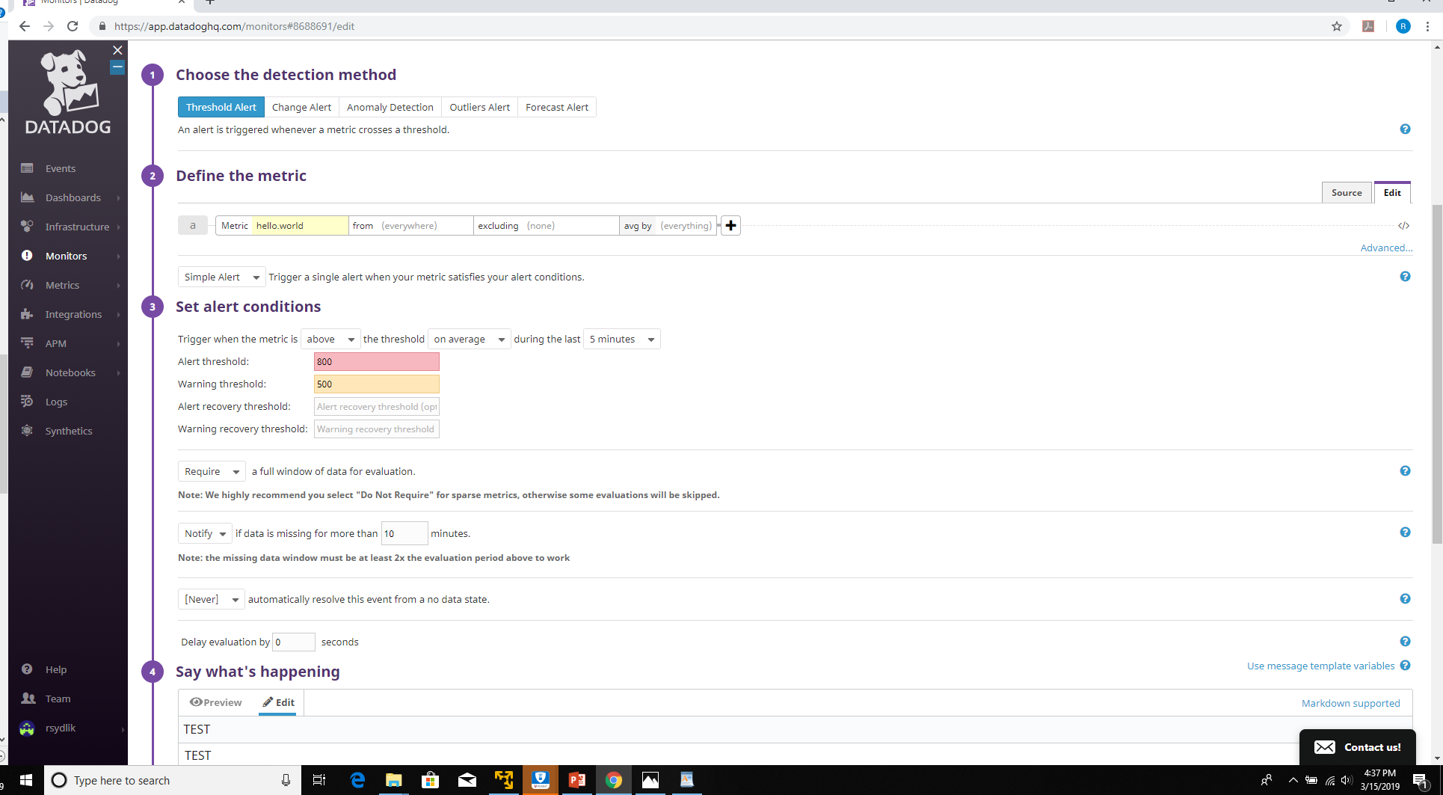
For the Hello World metric I set the Alert to 800, the Warning to 500, the Average to 5 minutes and the Notify Missing data for 10 minutes. This is visible in the screenshot
* Warning threshold of 500
* Alerting threshold of 800
* And also ensure that it will notify you if there is No Data for this query over the past 10m.

Slide 41
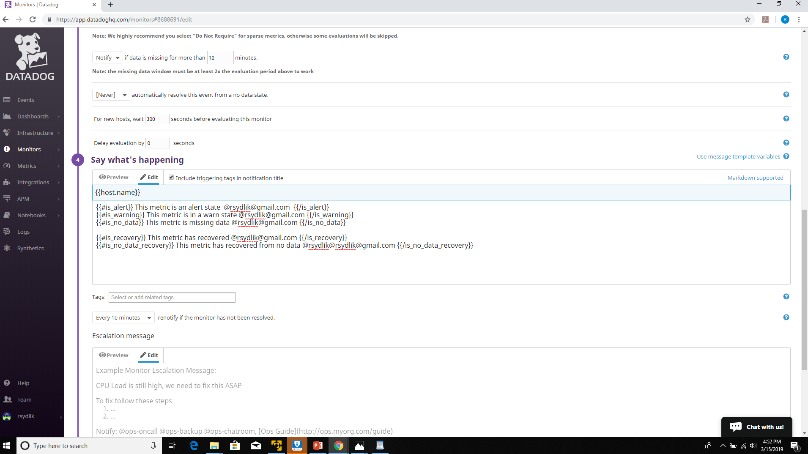
Email is configured to send, different messages sent based on Alert, Warning or No Data as shown. Perhaps over-configured…
* Send you an email whenever the monitor triggers.
* Create different messages based on whether the monitor is in an Alert, Warning, or No Data state.

Slide 42
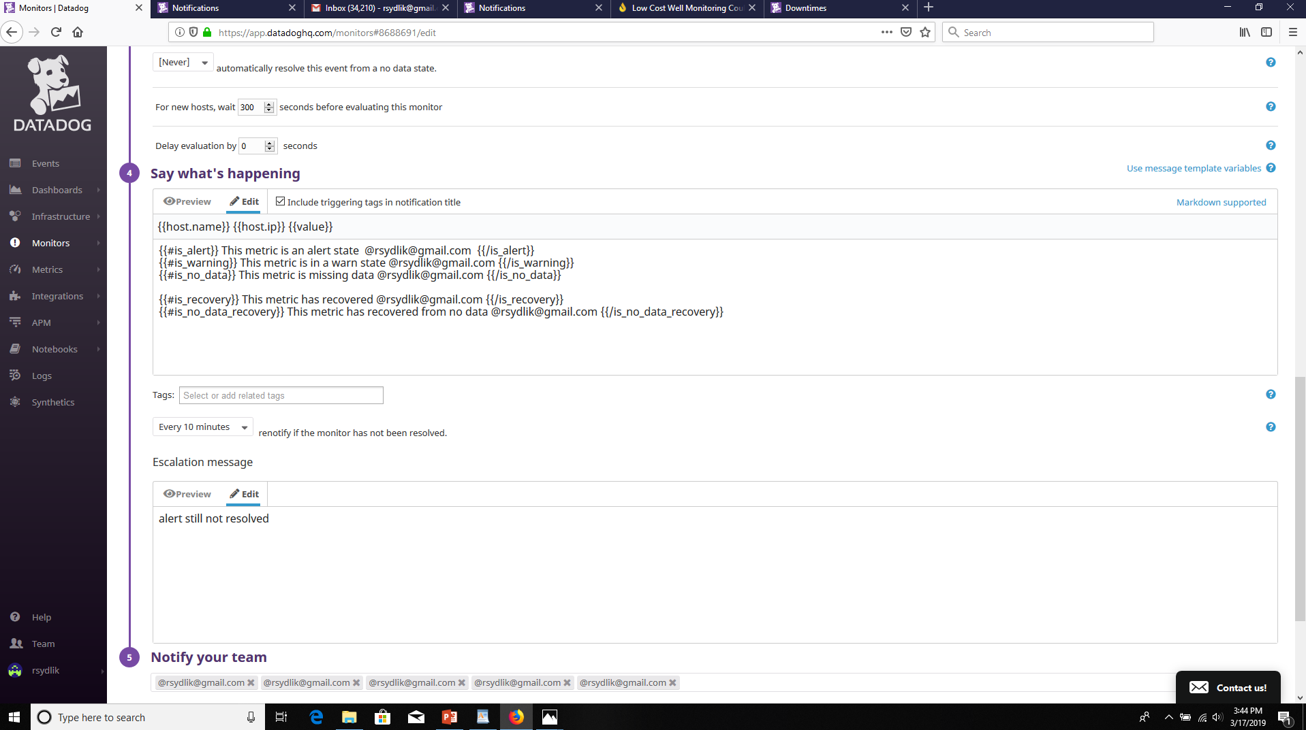
* Include the metric value that caused the monitor to trigger and host IP when the Monitor triggers an Alert state.
I added the {{}} for host.ip and value which will display these two items

Slide 43
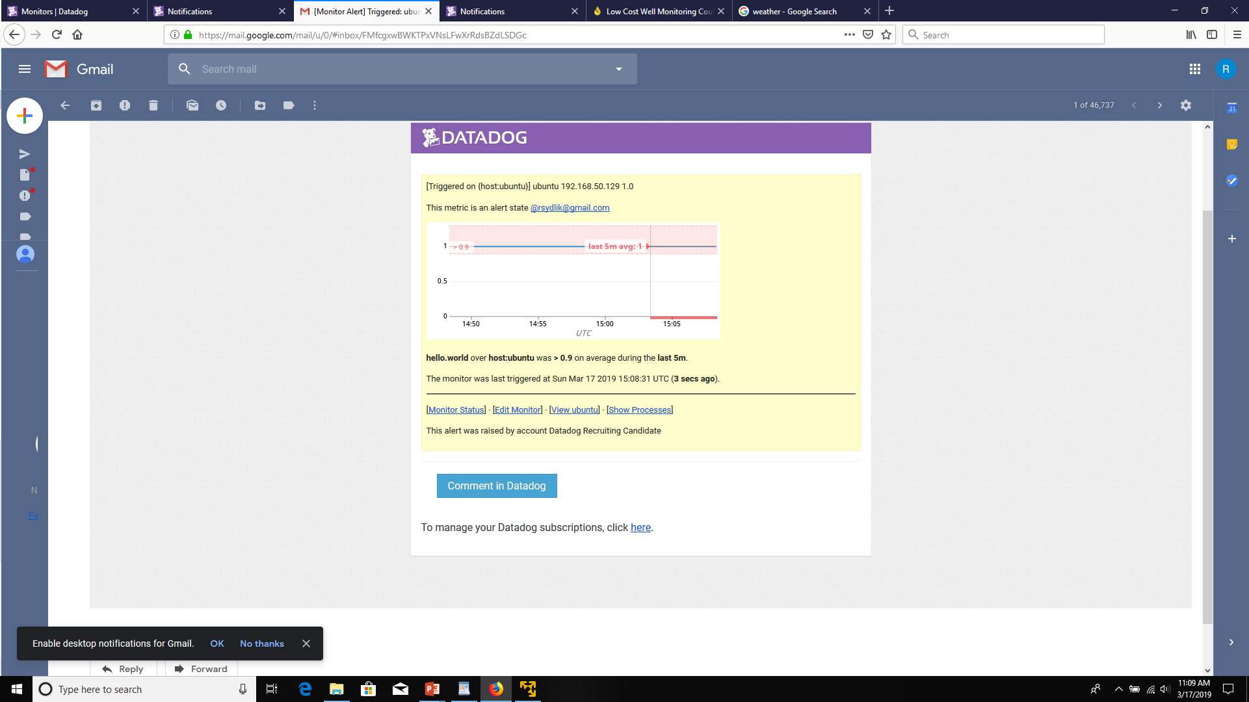
* When this monitor sends you an email notification, take a screenshot of the email that it sends you.
This is the email for the alert state. Note the IP address and the value.
(Note that I adjusted the threshold in order to actually trigger it).

Slide 44
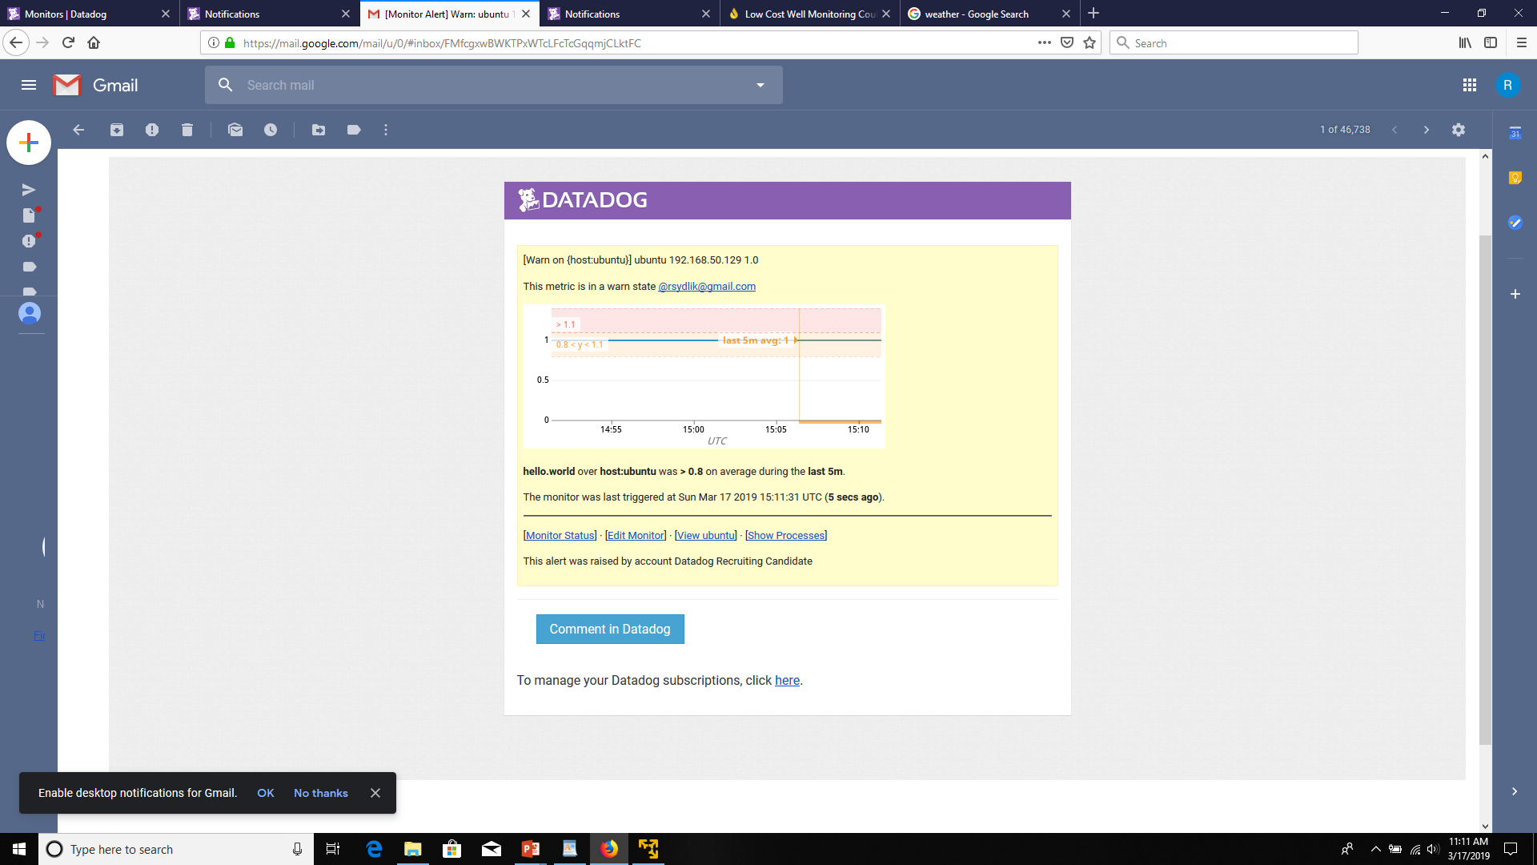
* When this monitor sends you an email notification, take a screenshot of the email that it sends you.
This is the email for the warning state. Note the IP address and the value.
(Note that I adjusted the threshold in order to actually trigger it).

Slide 45
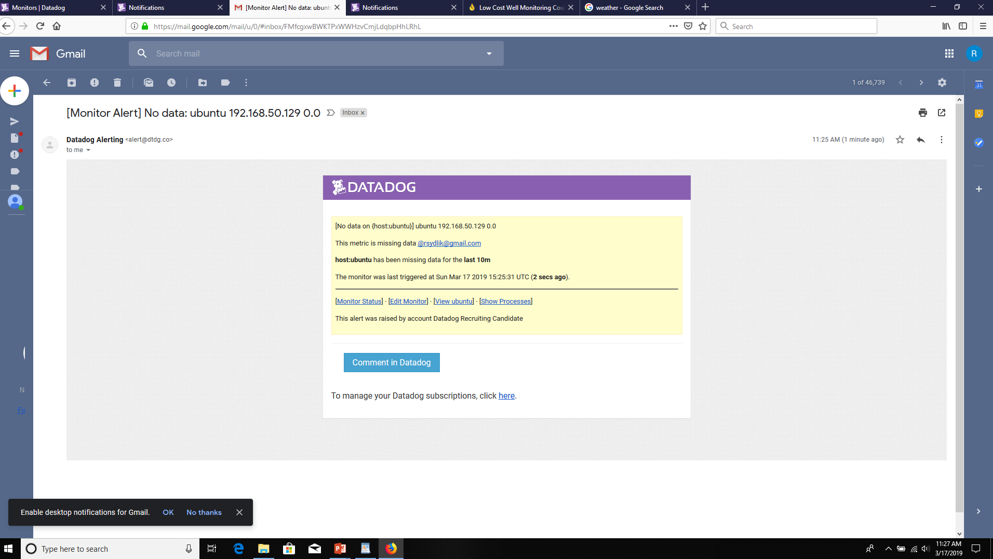
* When this monitor sends you an email notification, take a screenshot of the email that it sends you.
This is the email for the No Data state. I stopped the agent and shut down the Ubuntu VM to trigger it.

Slide 46
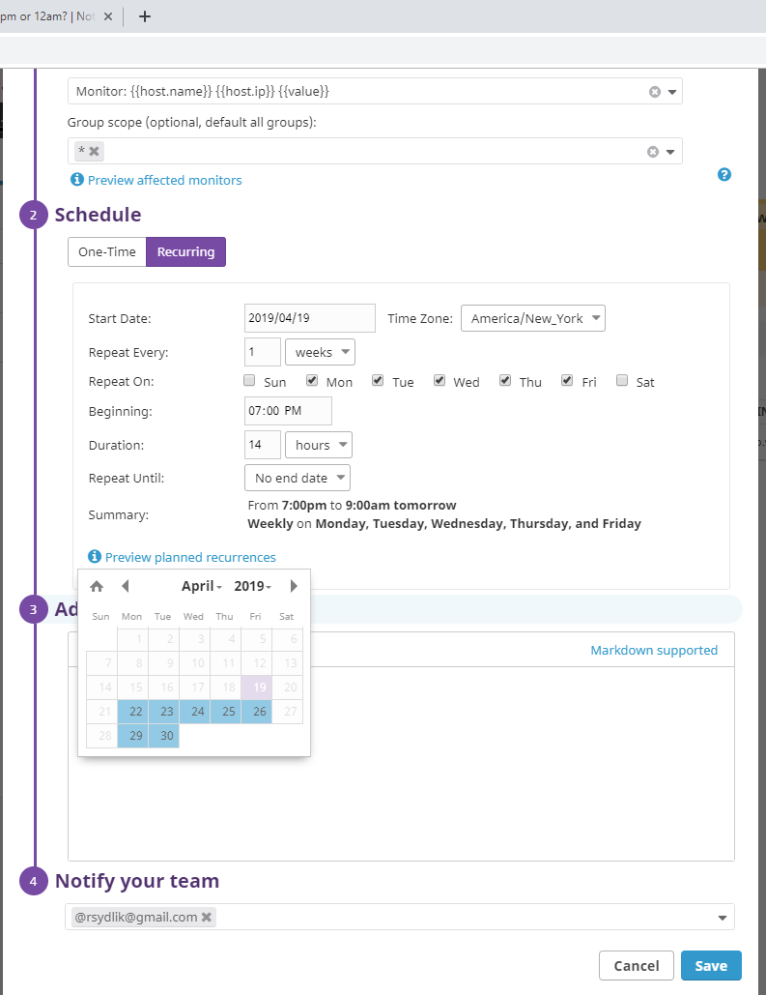
* One that silences it from 7pm to 9am daily on M-F
The alert is silenced from 7pm to 9am on weekdays

Slide 47
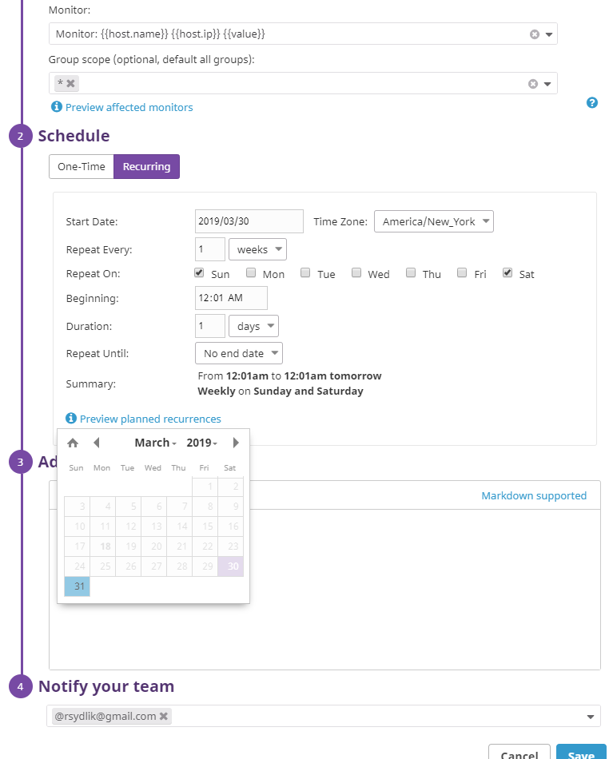
* And one that silences it all day on Sat-Sun.
The alert is silenced all day Saturday and Sunday.

Slide 48
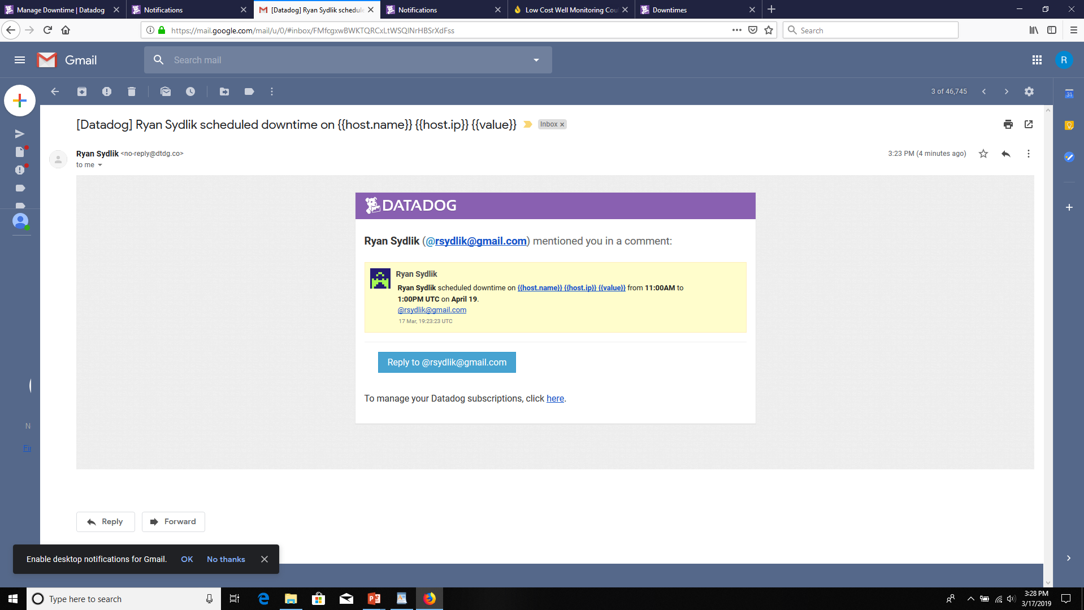
* Make sure that your email is notified when you schedule the downtime and take a screenshot of that notification.
The following is a notification of when I set the downtime. It is outdated as it was originally set from 7am to 9am and it is now 7pm to 9am. But, it demonstrates that the notifications are working. (Note that times are sent in UTC).

Slide 49
## Collecting APM Data:
Part 5

Slide 50
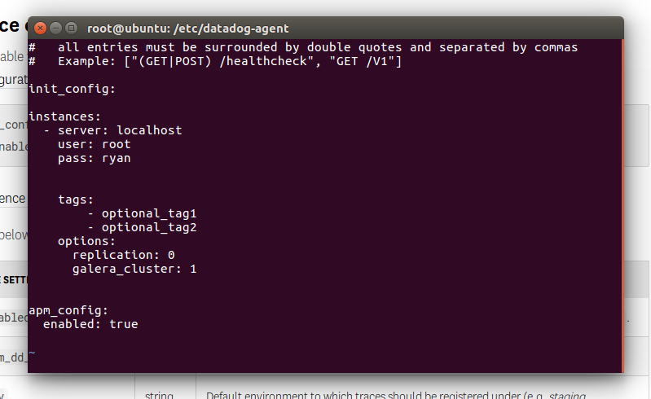
Given the following Flask app (or any Python/Ruby/Go app of your choice) instrument this using Datadog’s APM solution:
I enabled the integration for APM in the datadog.yaml file.

Slide 51
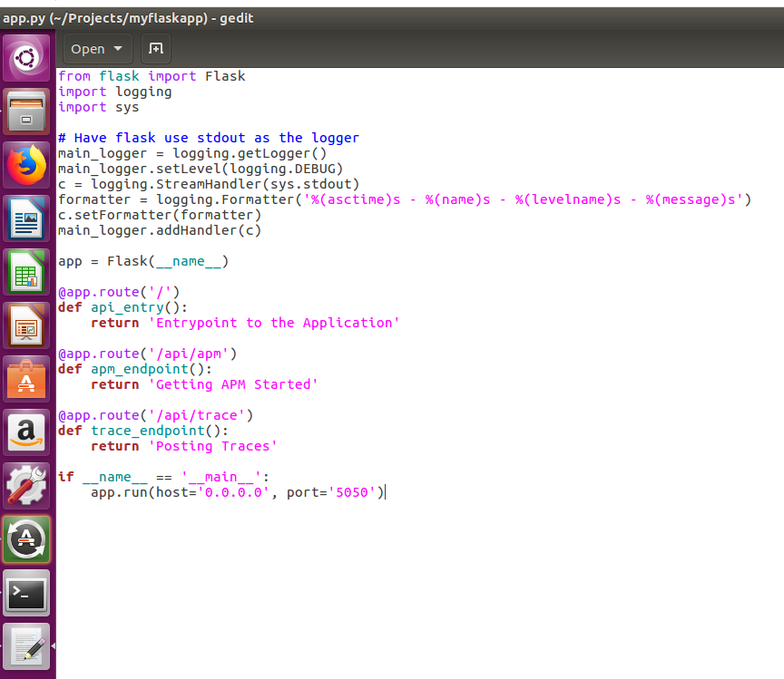
Given the following Flask app (or any Python/Ruby/Go app of your choice) instrument this using Datadog’s APM solution:
I copied the flask app into a Python file. This is the one that came with the exercise.

Slide 52
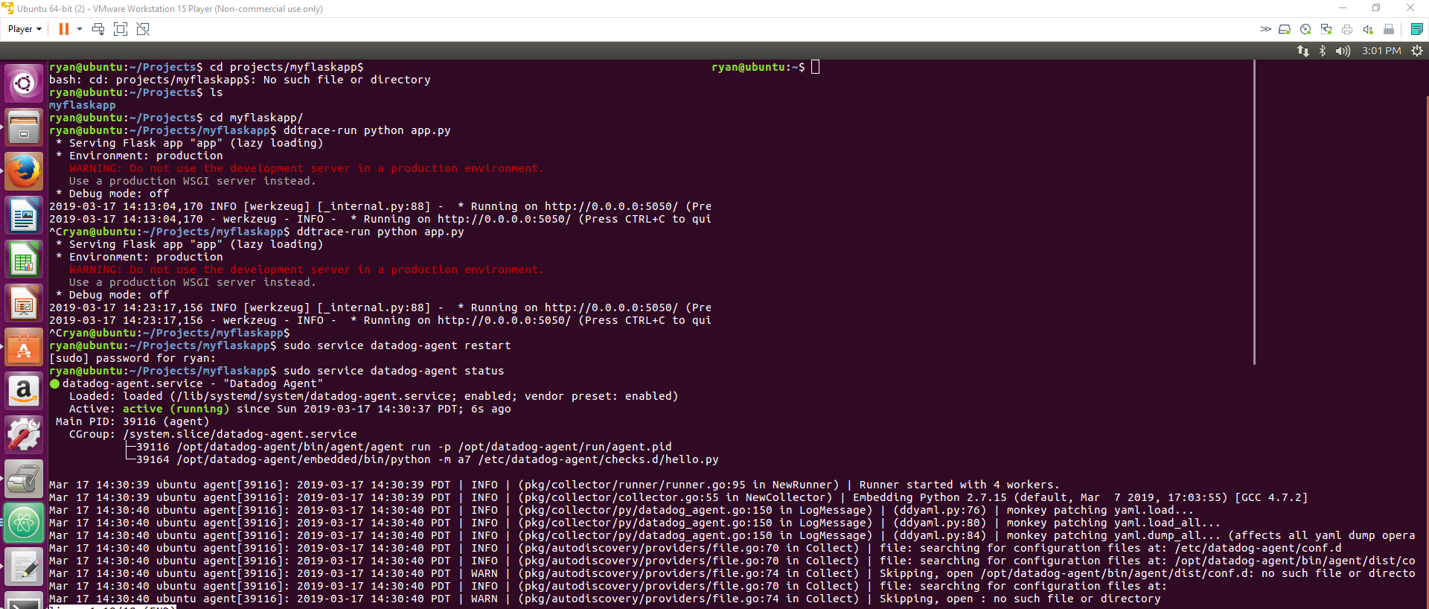
Given the following Flask app (or any Python/Ruby/Go app of your choice) instrument this using Datadog’s APM solution:
I ran pip install flask. I ran pip install ddtrace to get the tracing installed. I then ran ddtrace-run python app.py. The trace started running.

Slide 53
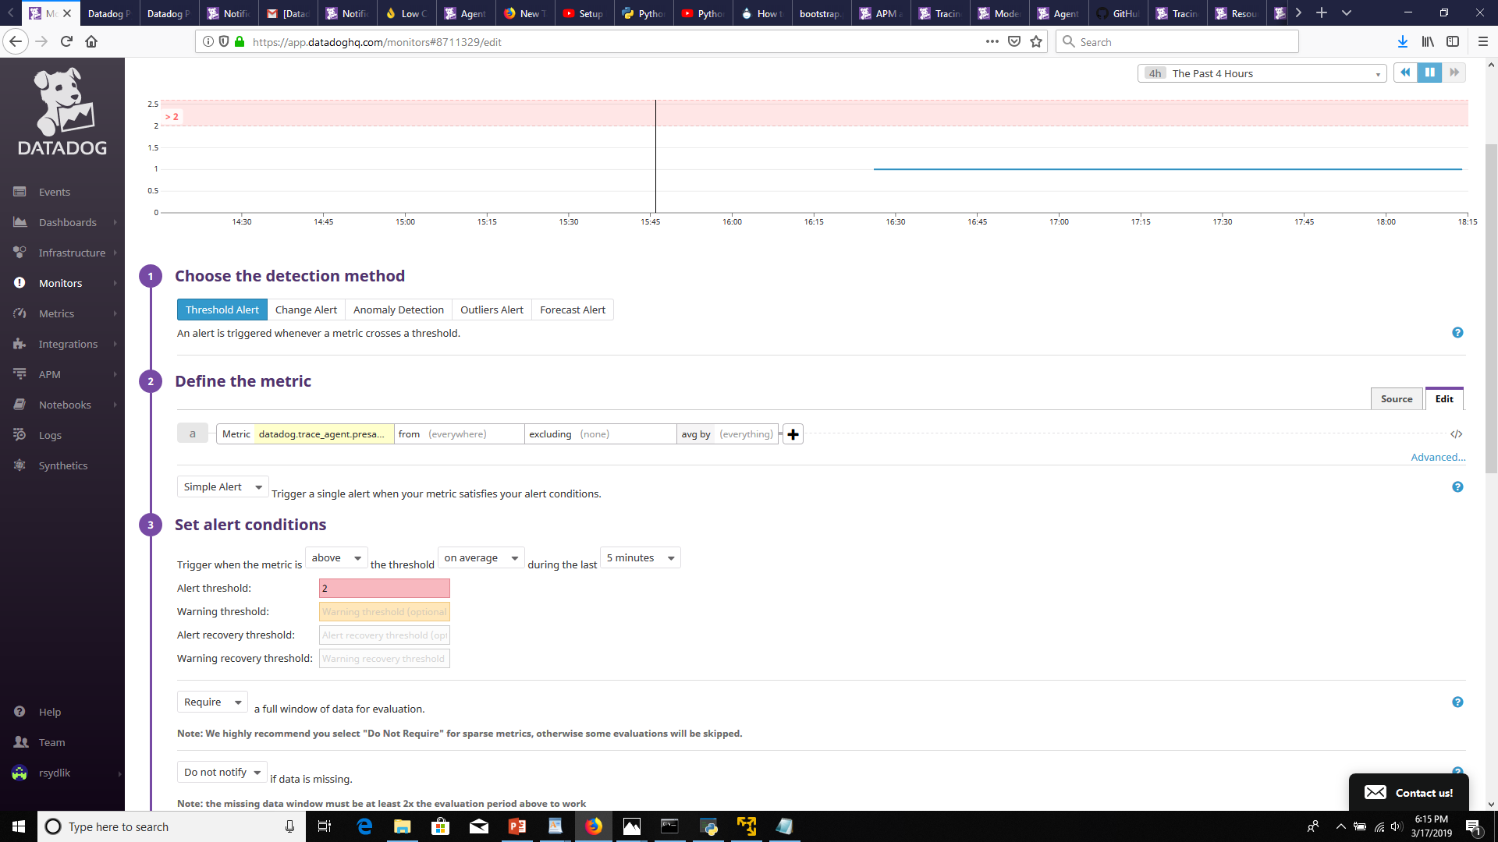
Given the following Flask app (or any Python/Ruby/Go app of your choice) instrument this using Datadog’s APM solution:
I see a metric related to the datadog.trace_agent appear which is good. But it is not a specific trace…

Slide 54
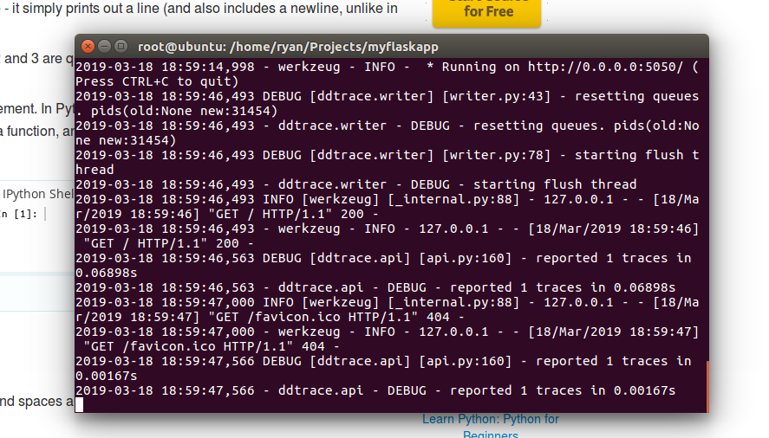
Given the following Flask app (or any Python/Ruby/Go app of your choice) instrument this using Datadog’s APM solution:
It takes awhile for the trace to appear. I thought it was broken so I looked at Go and Ruby instead. However, I eventually came back and finally the Python/Flask trace ran as expected.

Slide 55
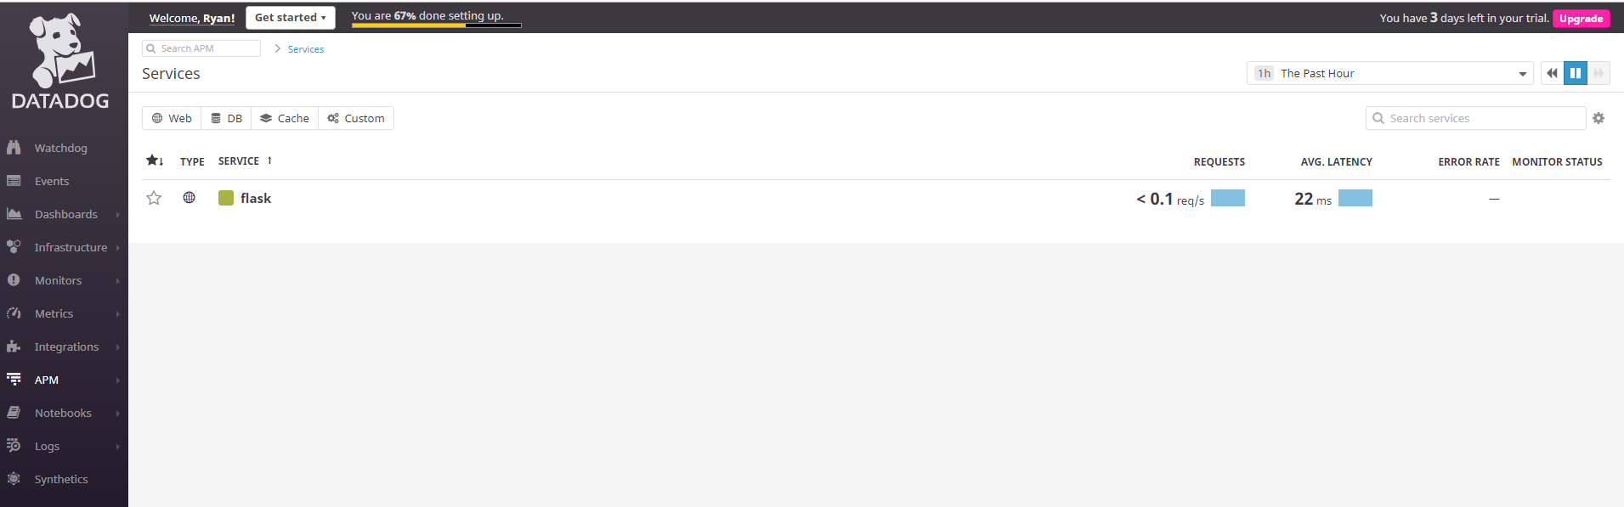
Provide a link and a screenshot of a Dashboard with both APM and Infrastructure Metrics.
The trace successfully picked up the flask service!

Slide 56
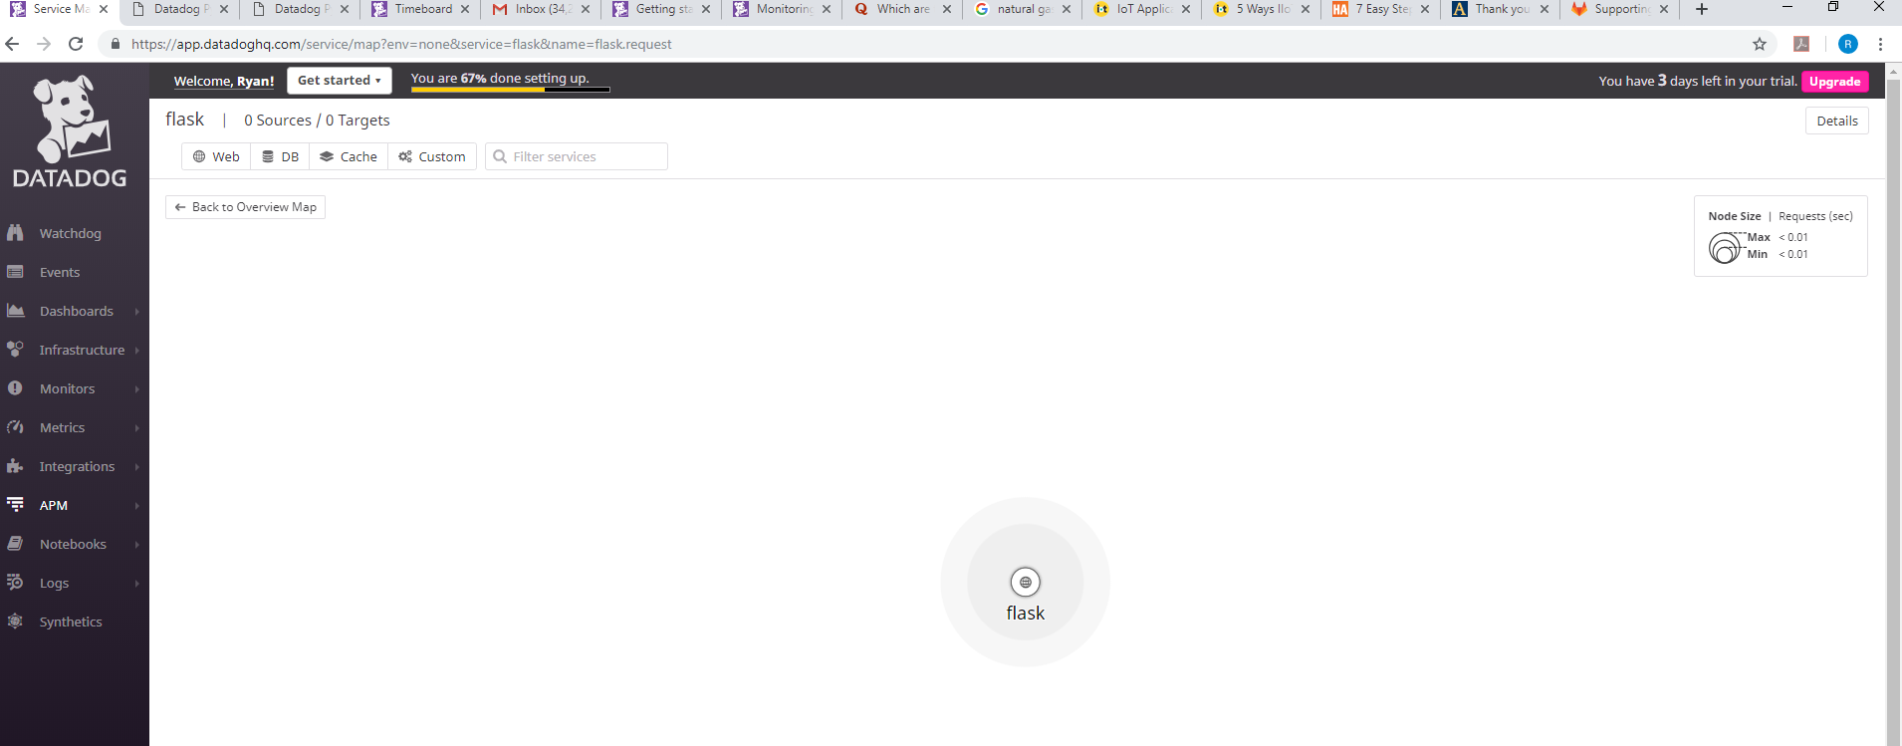
Provide a link and a screenshot of a Dashboard with both APM and Infrastructure Metrics.
Another screenshot from APM! Not much to see but glad its working now!

Slide 57
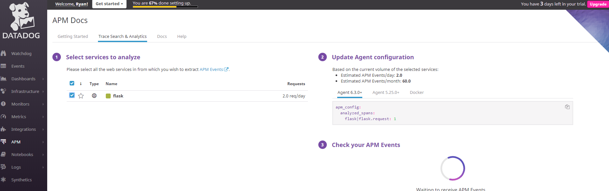
Provide a link and a screenshot of a Dashboard with both APM and Infrastructure Metrics.
Another screenshot from APM!

Slide 58
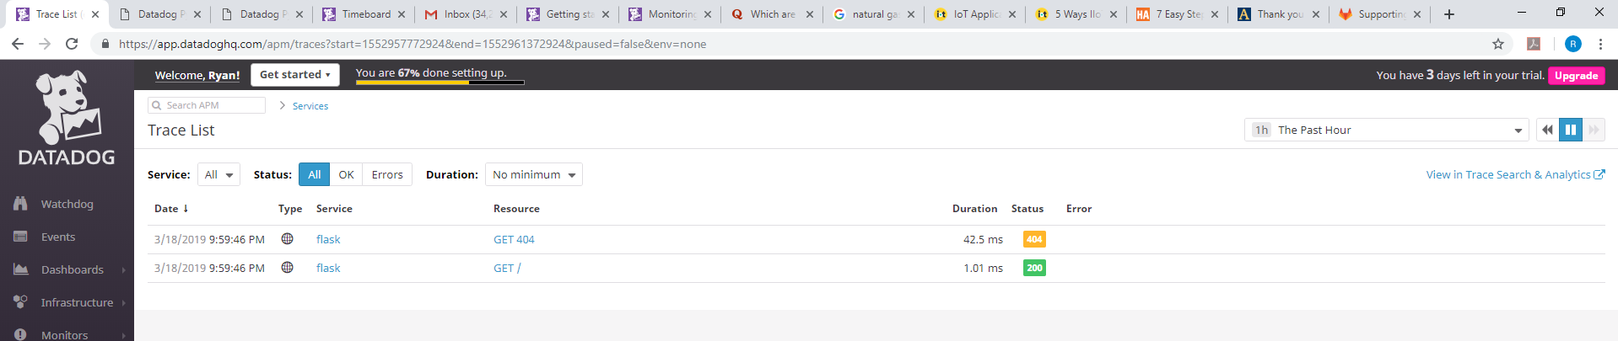
Provide a link and a screenshot of a Dashboard with both APM and Infrastructure Metrics.
I can see a breakdown of resources by service.

Slide 59
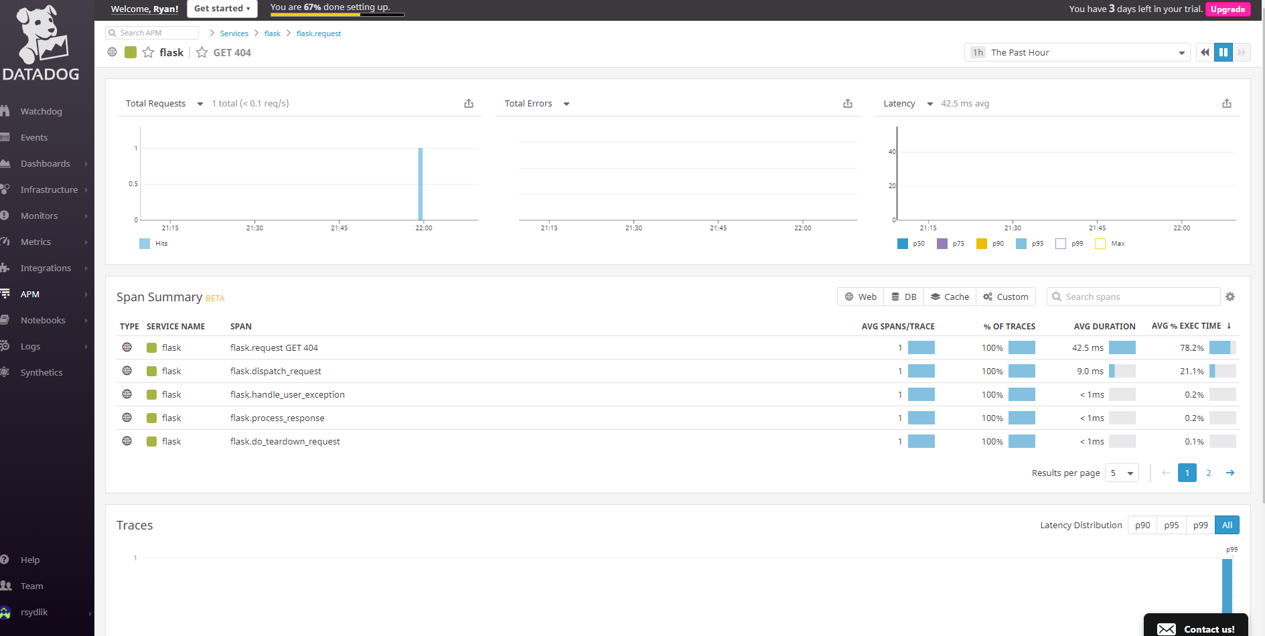
Provide a link and a screenshot of a Dashboard with both APM and Infrastructure Metrics.
Even for a simple application, APM returns quite a bit of info.

Slide 60

Provide a link and a screenshot of a Dashboard with both APM and Infrastructure Metrics.
Here I create an APM graph for trace.flask based on the request duration by service over 90%

Slide 61

Provide a link and a screenshot of a Dashboard with both APM and Infrastructure Metrics.
Here I create an APM graph for trace.flask based on the request hits.

Slide 62

Provide a link and a screenshot of a Dashboard with both APM and Infrastructure Metrics.
Here I create an APM graph for trace.flask based on the request duration by resource_service over 50%.

Slide 63

Provide a link and a screenshot of a Dashboard with both APM and Infrastructure Metrics.
https://app.datadoghq.com/dashboard/mf7-2zg-tah/apm-timeboard?tile_size=m&page=0&is_auto=false&from_ts=1552359600000&to_ts=1552964400000&live=true
1 graph for the trace agent heartbeat, 3 graphs for the Ubuntu host, 2 graphs for MySQL and 3 for the Python Flask application

Slide 64
* **Bonus Question**: What is the difference between a Service and a Resource?
A Service is a set of processes that do the same job. For example, a web application might consist of 2 services. The WebApp portion will do one job and the Database Service will do another job.
A Resource is an action that a service performs. For example, a resource for a Database service can be a single database query.

Slide 65


Final Question (Brand New Industry)
Pittsburgh has numerous companies and start-ups related to self driving vehicles
Some of these like Uber are major AWS and IOT users
Others such as Argo AI are small, but are well funded by large automakers
There are a myriad of ways to potentially leverage Datadog for autonomous vehicles in the Ohio Valley Region

Slide 66


Final Question (Legacy Industry)
In Western PA, natural gas production is a major industry. A Datadog IOT integration, whether custom or dedicated would be helpful in the following ways:
Improved Cost and Operational Efficiency by determining when to turn on or turn off natural gas wells
Improved Safety by monitoring for potentially dangerous conditions of well operation
Improved Environmental Benefits by more efficiently utilizing wells

